Slide 1
PATTERN
TEACHING
ABOUT
A step-by-step learning experience guide for Year 7-8 Visual Arts teachers

Slide 2
- Australian Curriculum, Assessment and Reporting Authority. (n.d.). The Arts – Visual Arts: Rationale. Australian Curriculum. https://www.australiancurriculum.edu.au/f-10-curriculum/the-arts/visual-arts/rationale/
“ The visual arts has the capacity to engage, inspire and enrich the lives of students, encouraging them to reach their creative and intellectual potential by igniting informed, imaginative and innovative thinking”

Slide 3
RESEARCH PHASE
Alignment to VCAA Yr.7-8 strands:
“Explore and Express Ideas”
Explore ideas, experiences, observations and imagination to create visual artworks
“Respond & Interpret”
Respond to visual artworks and consider where and why people make visual artworks

Slide 4
1
Process
2
3
Introduction to print
Students learn about art and design elements and principles and how patterns are made up of different elements. Students learn to identify four types of pattern: Natural, Geometric, Man-made & Irregular. Students choose one of the four to research further.
Research essay
Students pick an artist and 3 relevant artwork examples to research and write a short essay about why they chose it to build their theoretical knowledge and visual literacy skills (demonstrate initial understanding of how to talk about artworks e.g. use of line and colour within the pattern)
Exploration
Students explore nature and their surroundings to find examples of pattern use in their daily life. These are to be documented in their folios and hared with the class.

Slide 5
Potential artists to research
Georgia O’KEEFFE
Bronwyn BANCROFT
Maurits ESCHER
teamLab
Bridget RILEY
Richard ALLEN
Michael KIDNER
Sam LEACH
Marian DREW
Joseph Mallord William TURNER
Huang YAN
Dhambit MUNUNGGURR
Nonggirrnga MARAWILI
Mavis NGALLAMETTA
Peta CLANCY
Yang YONGLIANG
Rosalie DE MERIC
https://www.artyfactory.com/art_appreciation/visual-elements/pattern.html

Slide 6
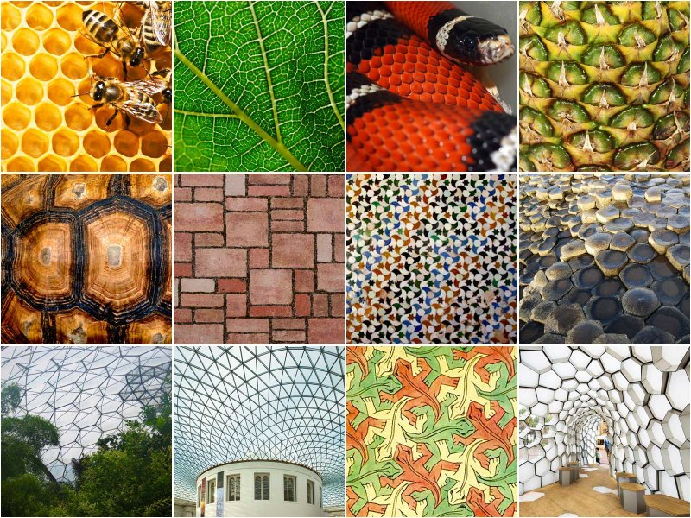
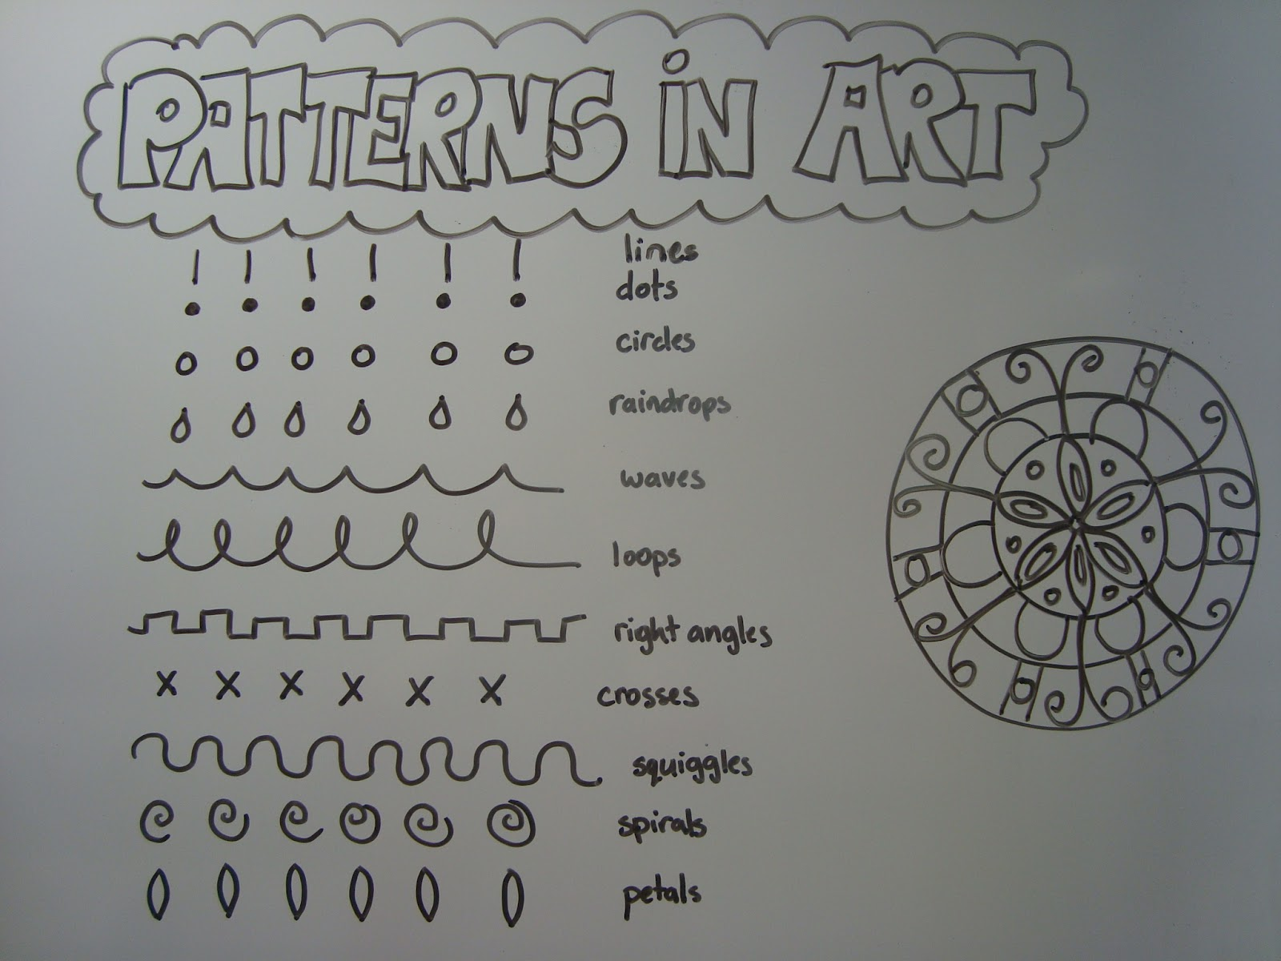
Student investigative task:
Examples of finding patterns in their everyday
landscapes

Slide 7
Suggested resource books:
Leoneschi, F., Ferraris, G., & Lazzaris, S. (2019). Patterns in art: A closer look at the old masters. Abbeville Press.
Kiely, O. (2018). Pattern. Conran
Meller, S., & Elffers, J. (1991). Textile designs: Two hundred years of European and American patterns organized by motif, style, color, layout, and period. Abrams.
Ball, P. (2016). Patterns in nature: Why the natural world looks the way it does. University of Chicago Press.
Briggs, J. (1992). Fractals: The patterns of chaos: A new aesthetic of art, science, and nature. Touchstone.
Leoneschi, F., & Lazzaris, S. (2019). Patterns in art: A closer look at the old masters. Abbeville Press.
Mattson, M. P. (2014). Superior pattern processing is the essence of the evolved human brain. Frontiers in Neuroscience, 8, 265. https://doi.org/10.3389/fnins.2014.00265
Norman, J. (1986). Patterns east and west: Introduction to pattern in art for teachers with slides and materials. Metropolitan Museum of Art.
Phillips, D. (1991). Patterns in pictures for art and science. Leonardo, 24(1), 31–39. https://doi.org/10.2307/1575785
Shen, X., Efros, A. A., & Aubry, M. (2019). Discovering visual patterns in art collections with spatially-consistent feature learning. In Proceedings of the IEEE Conference on Computer Vision and Pattern Recognition (CVPR). https://arxiv.org/abs/1903.02678v2
Swan, L. S. (2013). Deep naturalism: Patterns in art and mind. The Journal of Mind and Behavior, 34(2), 105–120.

Slide 8
MAKING PHASE
Alignment to VCAA Yr.7-8 strands:
“Visual Arts practices”
Experiment with different materials and techniques to make artworks
“Explore and Express Ideas”
Explore ideas, experiences, observations and imagination to create visual artworks

Slide 9
Creative process
02
03
01
Design & Composition
Materials & Techniques
Idea generation
Students generate sketch ideas of a simple motif inspired by their research phase. They must consider the use of elements and principles.
After choosing their refined motif, students use drop templates to experiment with placement and composition. Students produce four miniature mockups of their pattern design
Students use their motif to explore mixed-media methods:
Collage -cutting motif shapes out of paper to create a pattern or using a photocopier/CAD to duplicate digitally.
Printmaking- creating a linocut block to print their repeating motif into a pattern on paper

Slide 10
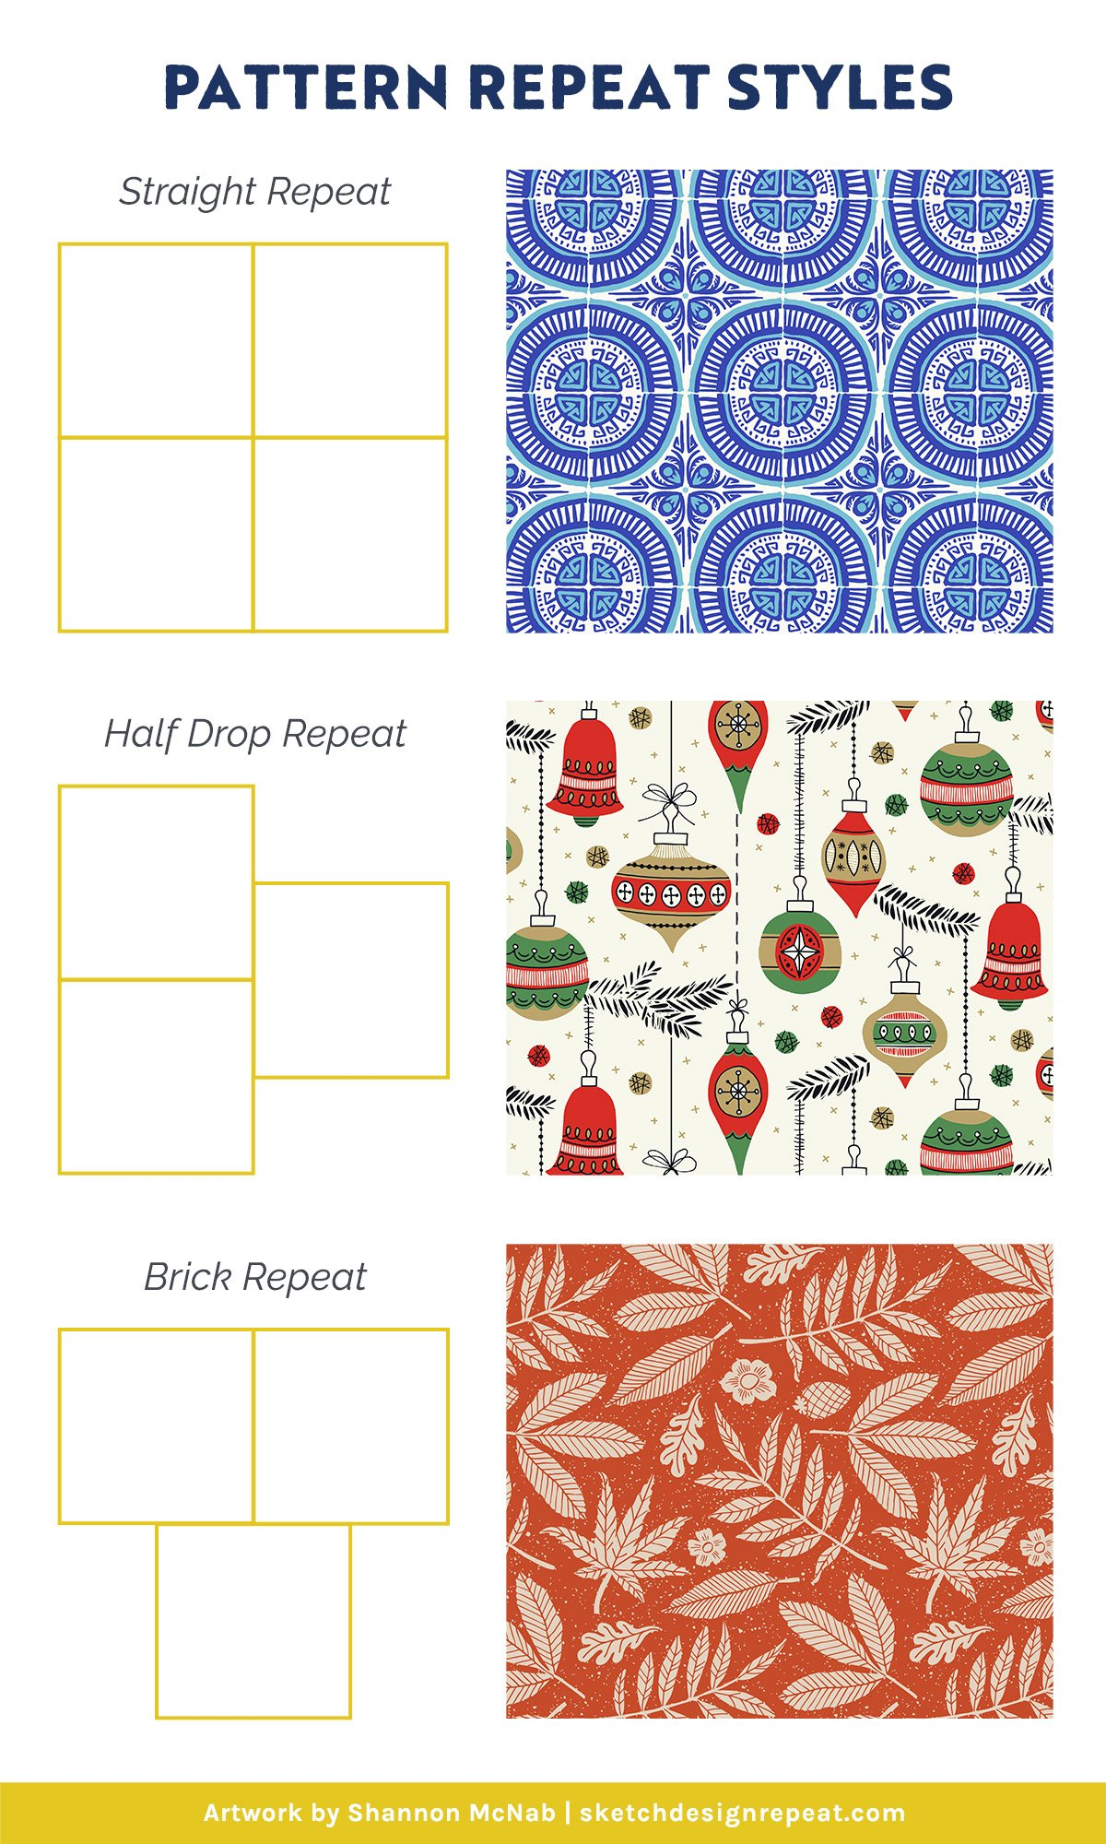
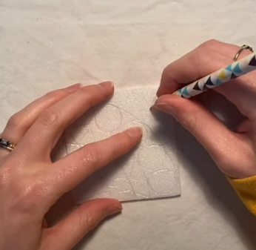
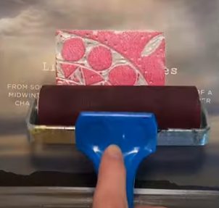
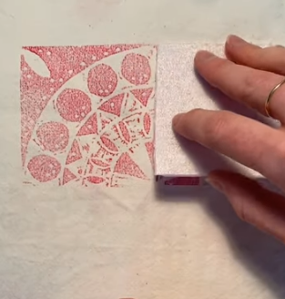
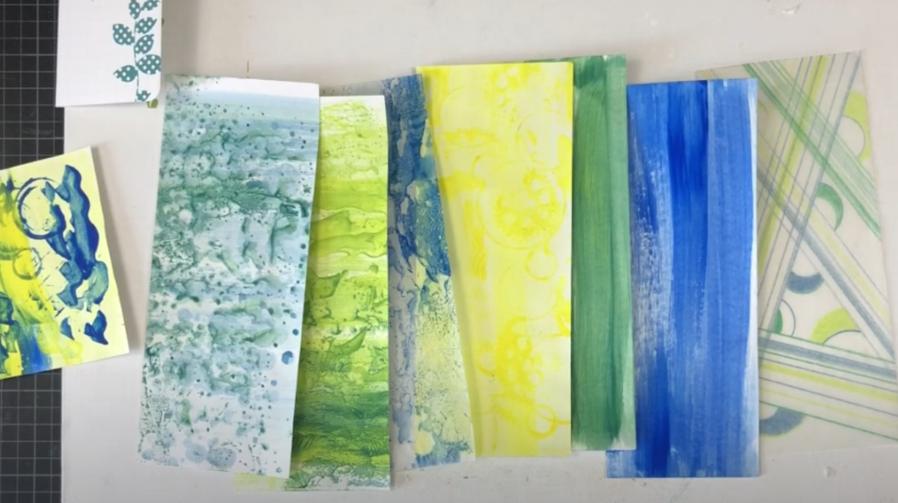
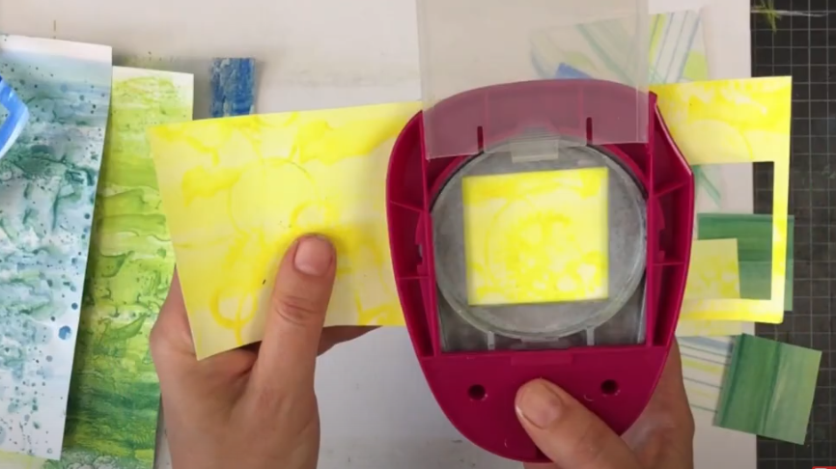
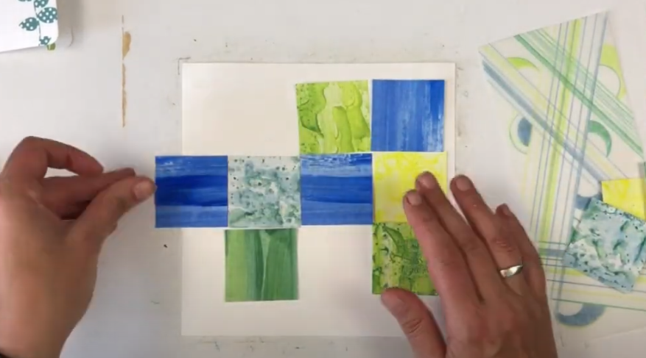
Examples of artmaking processes:
Drop placement templates
Printmaking with lino blocks
https://www.youtube.com/watch?v=MNGLEopn4b8
Pattern collage with paper
https://www.youtube.com/watch?v=RuPm42oIhUM

Slide 11
Digital resources for students:
How to create pattern motif template on Illustrator:
https://www.youtube.com/watch?v=zhprfKhb8Og
How to create a pattern on Procreate:
https://www.youtube.com/watch?v=R_5TQeV1FNg
How to use Photoshop to create motif pattern
https://www.youtube.com/watch?v=hfjPyxNM-zs
Linocut Basics
https://www.youtube.com/watch?v=jL9e8OPHOLI
Printing a repeat pattern using linoblock
https://www.youtube.com/watch?v=MNGLEopn4b8

Slide 12
PRESENT & REFLECT PHASE
Alignment to VCAA Yr.7-8 strands:
“Present & Perform”
Create and display artworks
“Respond & Interpret”
Respond to visual artworks and consider where and why people make visual artworks

Slide 13
Process:
1
2
3
Understanding creative practice
Students watch short videos showing a diverse range of artists’ artmaking processes to gain insight on materials, techniques and reflect on their own creative process thus far.
Final artwork
Students choose what materials, techniques and creative method they wish to use for their final artwork based on their mockups. Students produce one A4 size piece of work using either collage or printmaking.
Present & Display
Students document their artmaking and design process in their folios using reflective annotations. The students and teacher collaborate to curate a section of their classroom to display their final pieces and share feedback.

Slide 14
ALIGNMENT TO GENERAL CAPABILITIES (ACARA, Version 8.4)

Slide 15
“In the Australian Curriculum, General Capabilities encompass knowledge, skills, behaviours, and dispositions that, together with curriculum content in each learning area and the cross-curriculum priorities, will enable students to live and work successfully in the 21st century”- (ACARA,n.d)

Slide 16
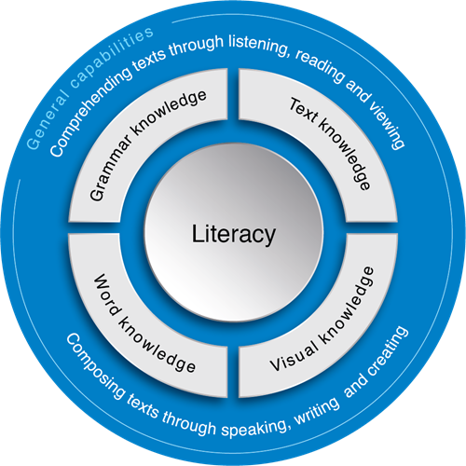
LITERACY
Texts encompass various communication forms, including written, spoken, visual, multimodal, and digital (Gee, 2008). In the Australian Curriculum: The Arts, students use literacy to develop and express their skills as artists and audiences (ACARA, n.d.).
During the Research Phase, students enhance literacy by composing, analysing, interpreting, and evaluating an artist and their works. Vygotsky (1987) emphasizes that language and concept development are interconnected, with social practice playing a key role. As students progress, they apply art-specific terminology (e.g., formal elements and principles), fostering dynamic and flexible language use in verbal and written expression.
In the final stage, students meet the Literacy Capability by engaging with multimodal texts, such as film, presentations, and photography, which explore human experience and aesthetics (ACARA, n.d.). Additionally, class discussions in the Making Phase strengthen their ability to analyse, critique, and comprehend instructions.

Slide 17
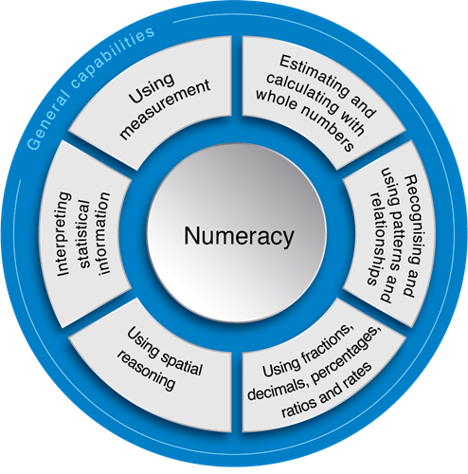
NUMERACY
“I am interested in mathematics only as a creative art…..
A mathematician, like a painter or a poet, is a maker of patterns. If his patterns are more permanent than theirs, it is because they are made with ideas” (Hardy, 1941)
The Australian Curriculum emphasizes that students develop the knowledge, skills, and attitudes to apply mathematics in various contexts and daily life (ACARA, n.d.).
In the Research Phase, students explore recurring patterns in nature, gaining insight into mathematical and physical principles such as fractals and symmetry. During the Present Phase, they organize, analyse, and represent data related to their own or others’ artworks, enhancing their ability to identify and sort key features through the creative process. Engaging with the open space of the art room throughout all phases further supports their spatial awareness.
In the Making Phase, students apply proportional reasoning, scale, and ratio to design and arrange motifs within their compositions. In printmaking, they create repeated patterns by manipulating a basic design through folding, cutting, and reassembling. Additionally, multimodal materials and digital tools enhance their understanding of 2D-to-3D translation and measurement skills for calculating length and area.

Slide 18
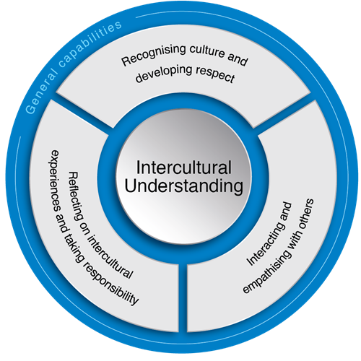
INTERCULTURAL UNDERSTANDING
“Culture does not make people. People make culture.”
— Chimamanda Ngozi Adichie, 2014.
In the Australian Curriculum: The Arts, Intercultural Understanding allows students to explore how cultural identities, languages, beliefs, and traditions influence artists and audiences (ACARA, n.d.).
During the Research Phase, students critically examine artists from diverse cultural backgrounds, challenging preconceived roles, images, objects, sounds, and practices. This exposure fosters empathy and open-mindedness toward unfamiliar contexts.
In the Making Phase, students’ motifs may reflect their own cultural perspectives and identities, encouraging self-reflection and connections with others.
When presenting their final artworks and collaborating on the class display, teachers can guide discussions on navigating differences, respecting personal ideas, and applying critical thinking to intercultural understanding.

Slide 19
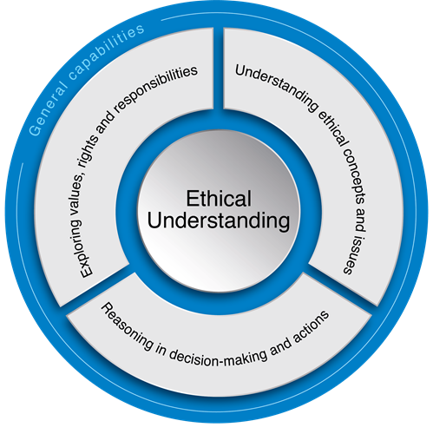
ETHICAL UNDERSTANDING
The Australian Curriculum promotes ethical understanding by fostering reasoning, judgment, and awareness of how values and actions affect others (ACARA, n.d). Students develop personal integrity, resilience, empathy, and respect, equipping them to navigate conflict and uncertainty. Aligned with the Melbourne Declaration (MCEETYA, 2008), this foundation supports ethical decision-making and responsible citizenship.
This learning experience asks students to find patterns within their everyday contexts, drawing awareness to the signs and symbolism that may be present in our consumerist society. Students develop ethical awareness by discussing issues that may arise through this project and reflecting on ideas as a group to model a democratic community.
The theme of ‘patterns’ aims to broaden students’ understanding of the visual language of art, enabling them to communicate their ideas in an ethical manner that considers how life experiences shape their own and others’ decision-making. Through interpreting and evaluating artworks, students gain insight into values and ethical principles, including respect for the intellectual, moral, and property rights of professional artists and their peers. An example of this would be ensuring that they reference the artist’s information when annotating in their folios, while considering the implications of copying others’ work. Students will also learn about ethical and cultural protocols when engaging with Aboriginal and Torres Strait Islander Peoples, their histories, cultures, and artistic traditions.

Slide 20
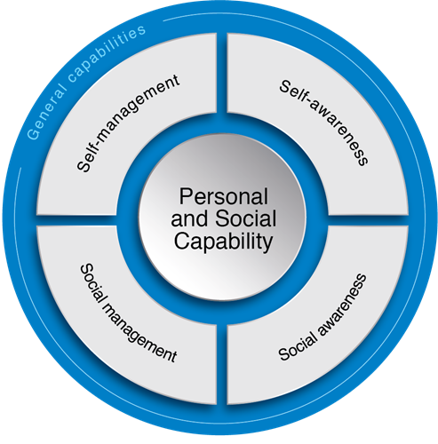
PERSONAL & SOCIAL CAPABILITY
Studying Visual Arts extends beyond technical skills, fostering cognitive, social, and emotional development of diverse learners, reinforcing its importance in a well-rounded curriculum (Sheridan et al., 2022).
To manage their creative assignments, students develop self-discipline, time management, goal-setting, and autonomy while demonstrating initiative, responsibility, resilience, and adaptability (ACARA, n.d.). An arts-based curriculum embraces possibilities, encourages collaboration, and values dialogic discourse as a transformative process rather than merely an exchange of ideas (Rinaldi, 2021). During the Present Phase, collaborative work enhances students' social skills, enabling them to communicate effectively, make thoughtful group decisions, and exhibit leadership. According to ACARA (n.d.), personal and social capability fosters confidence, creativity, self-awareness, and resilience, helping students build positive relationships and manage their well-being. Additionally, recent research on Australasian learning environments highlight a positive correlation between creative learning spaces and students' emotional and physical well-being (Young et.al, 2019).

Slide 21
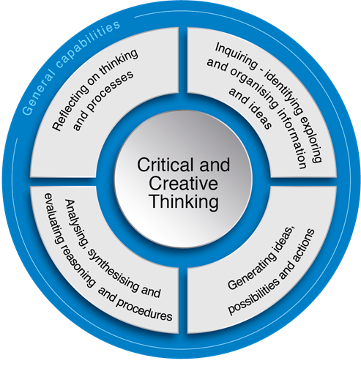
CRITICAL & CREATIVE THINKING
Creativity, interpretation, innovation, and critical understanding are highly valued in 21st-century industries (Garrett, 2009). In the Australian Curriculum: The Arts, critical and creative thinking underpin both art-making and response, as students use curiosity, imagination, and inquiry to explore ideas, spaces, materials, and technologies (ACARA, n.d.).
As part of their research essay, students analyse artistic patterns from the mid-19th century to contemporary times across diverse artists and art forms, strengthening their critical analysis, artistic voice, and expression (Israel, 2023). Imagination fosters empathy and understanding, with Britzman (2003) highlighting the role of educational experiences in human connection. He encourages teachers to embrace the "gifts of error" in the classroom, allowing space for creative reflection and innovative teaching. The Making Phase supports this by encouraging students to take risks and experiment before refining their ideas. Pattern recognition itself is a creative skill. Using nature as inspiration deepens students' understanding of visual conventions, offering endless opportunities for improvisation, imagination, analysis, and organization (Israel, 2023).
In the final Reflect & Present Phase, students evaluate and communicate their ‘pattern’ artwork in an analogue or digital format, applying critical and creative thinking to interpret, justify, and draw reasoned conclusions (ACARA, n.d.)

Slide 22
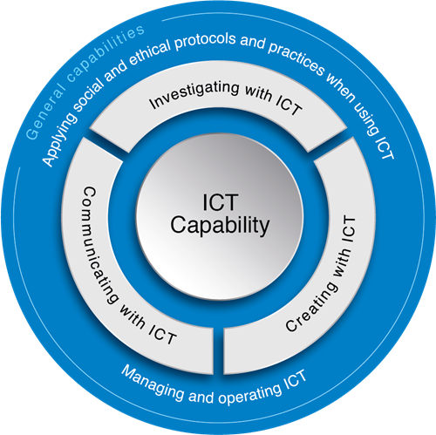
ICT CAPABILITY
In this learning experience, students use digital technologies to research, evaluate, collaborate, and communicate with diverse audiences. Integrating ICT as a pedagogical tool engages tech-savvy adolescents by incorporating familiar programs that enhance motivation.
In the Making Phase, students refine their ICT skills by experimenting with collage compositions, using CAD programs and photocopiers/printers to develop and duplicate motifs. This resource also offers software, multimedia platforms, and virtual tools to support design, creation, and sharing throughout the creative process. By utilising technology, students can engage in independent learning outside of the classroom through provided links to relevant content.
ACARA (n.d.) also highlights the importance of teaching students to follow social and ethical protocols, including acknowledging intellectual property and ensuring online security.

Slide 23
"Art is the imposing of a pattern on experience, and our aesthetic enjoyment is recognition of the pattern.“ —Alfred North Whitehead (British Philosopher and Mathematician, 1861–1947)

