Slide 1
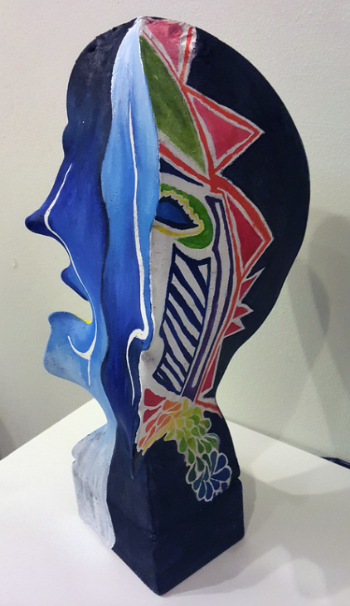
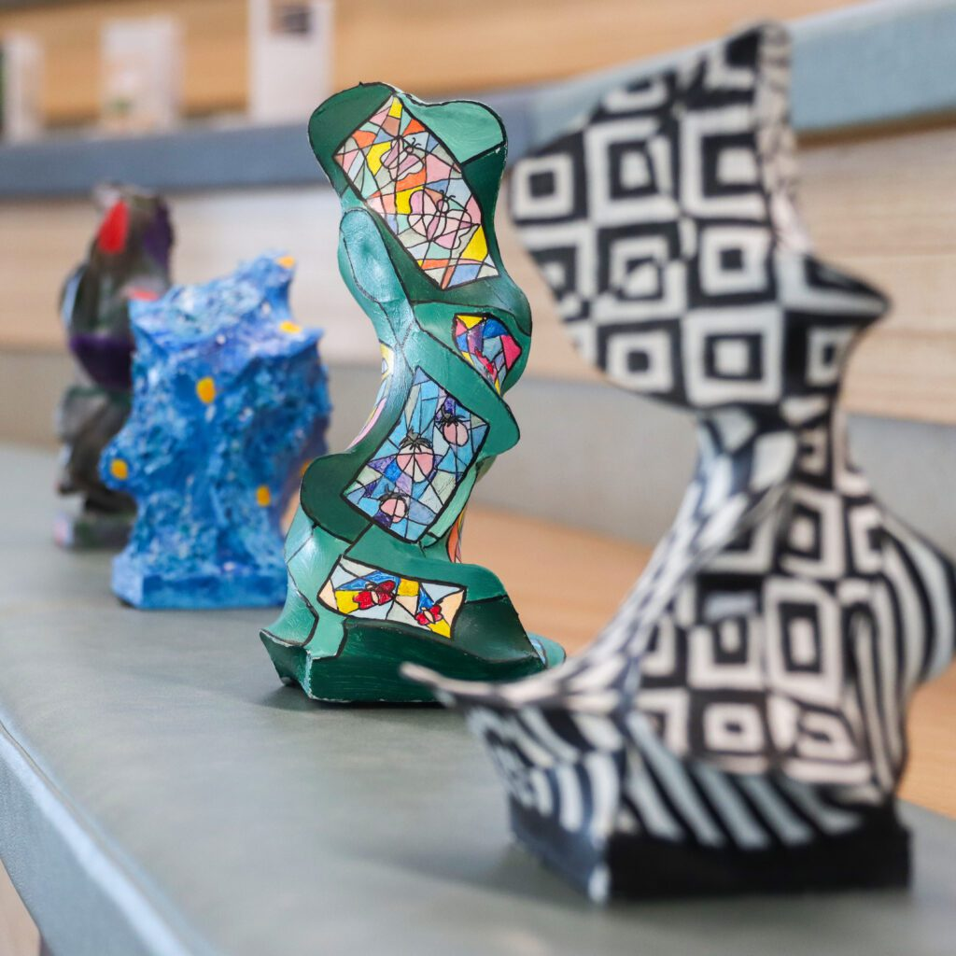
YEAR 10 ABSTRACT SCULPTURE TEACHER RESOURCE GUIDE
https://www.artedguru.com/3d-projects.html
https://blog.kildare.catholic.edu.au

Slide 2
ALIGNMENT TO CURRICULUM
Content descriptors taken from V.9 Curriculum (ACARA, 2025)
Visual Arts, Years 9 and 10
AC9AVA10E01 | investigate the ways that artists across cultures, times, places and/or other contexts develop personal expression in their visual arts practice to represent, communicate and/or challenge ideas, perspectives and/or meaning.
AC9AVA10D01 | experiment with visual conventions, visual arts processes and materials to refine skills and develop personal expression
AC9AVA10C02 | select and manipulate visual conventions, visual arts processes and/or materials to create artworks that reflect personal expression, and represent and/or challenge, ideas, perspectives and/or meaning
AC9AVA10C01 | evaluate critical feedback when planning, developing and refining their visual arts practice
AC9AVA10D02 | reflect on the way they and other visual artists respond to influences to inspire, develop and resolve choices they make in their own visual arts practice

Slide 3
TEACHING STRATEGIES
This is a slide structure based on a multi-purpose presentation for education
You can delete this slide when you’re done editing the presentation
CULTURALLY RESPONSIVE TEACHING | Integrates students' cultural backgrounds and lived experiences into art-making (Marshall, 2010) Values diverse traditions, artists, and ways of knowing (Gay, 2010)
INQUIRY-BASED LEARNING | Promotes curiosity through student-led questions and investigations. Encourages deeper critical thinking and interdisciplinary connections.
CHOICE-BASED ART EDUCATION | Encourages student agency by allowing choices in the subject matter and creative process. Supports differentiated learning and values students as artists (Douglas & Jaquith, 2009)
PROCESS-ORIENTATED PEDAGOGY | Emphasizes experimentation, play, and creative risk-taking over perfection in final products. (Rolling, 2010)
COLLABORATIVE LEARNING | Builds community and peer-to-peer learning through group critiques and projects. Reinforces habits like persistence, observation, reflection (Hetland et al., 2013).
VISUAL THINKING STRATEGIES | Uses open-ended questions to develop observation, interpretation, and communication skills. Effective for English language learners and neurodiverse students (Housen, 2002).

Slide 4
KEY SKILLS & CAPABILITIES
Create artworks to communicate ideas in 2D & 3D, multi-disciplinary or hybrid forms
Build confidence in visual conventions, processes and materials
Work collaboratively with peers and teachers
Evaluate how visual arts and their artwork celebrates and challenges concept of identity
Engage in the work of visual artists and their practices from diverse contexts
ACHIEVEMENT STANDARDS (ACARA, 2025)
By the end of Year 10, students analyse how and why visual conventions, visual arts processes and materials are manipulated in artworks they create and/or experience. They evaluate how and why artists from across cultures, times, places and/or other contexts use visual conventions, visual arts processes and materials in their visual arts practice and/or artworks to represent and/or challenge ideas, perspectives and/or meaning. They evaluate how visual arts are used to celebrate and challenge perspectives of Australian identity.
Students draw on inspiration from multiple sources to generate and develop ideas for artworks. They document and reflect on their own visual arts practice. They use knowledge of visual conventions, visual arts processes and materials to create artworks that represent and/or communicate ideas, perspectives and/or meaning. They curate and present exhibitions of their own and or/others’ artworks and visual arts practice to engage audiences.

Slide 5
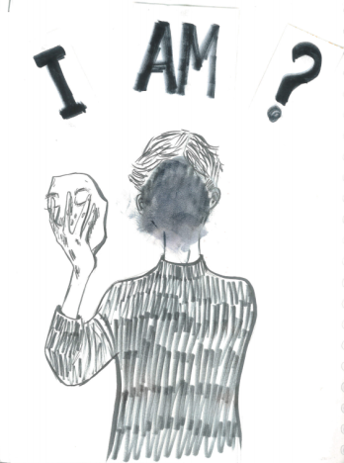
EXPLORING IDENTITY: BRAINSTORM PROMPTS
How do you define the concept of ‘identity’?
Is there a difference to how you want to be perceived and how others perceive you?
What experiences growing up shaped your identity?
Who has shaped who you are?
How do our moods and feelings impact who we are?
Do you have any physical identifiers (freckles, scars, birthmarks? Eye colour?)
Do we have just one identity?
Are we defined by our actions?
What is your social and cultural background?
Image taken from: https://dariaistocblog.wordpress.com/2020/04/26/identity-theme-brainstorming/

Slide 6
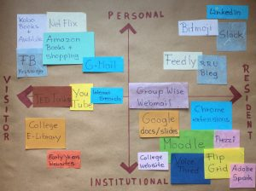
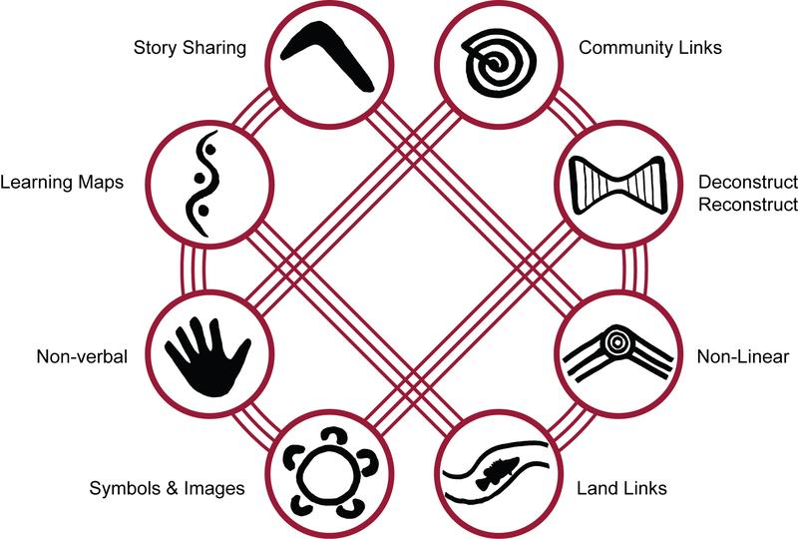
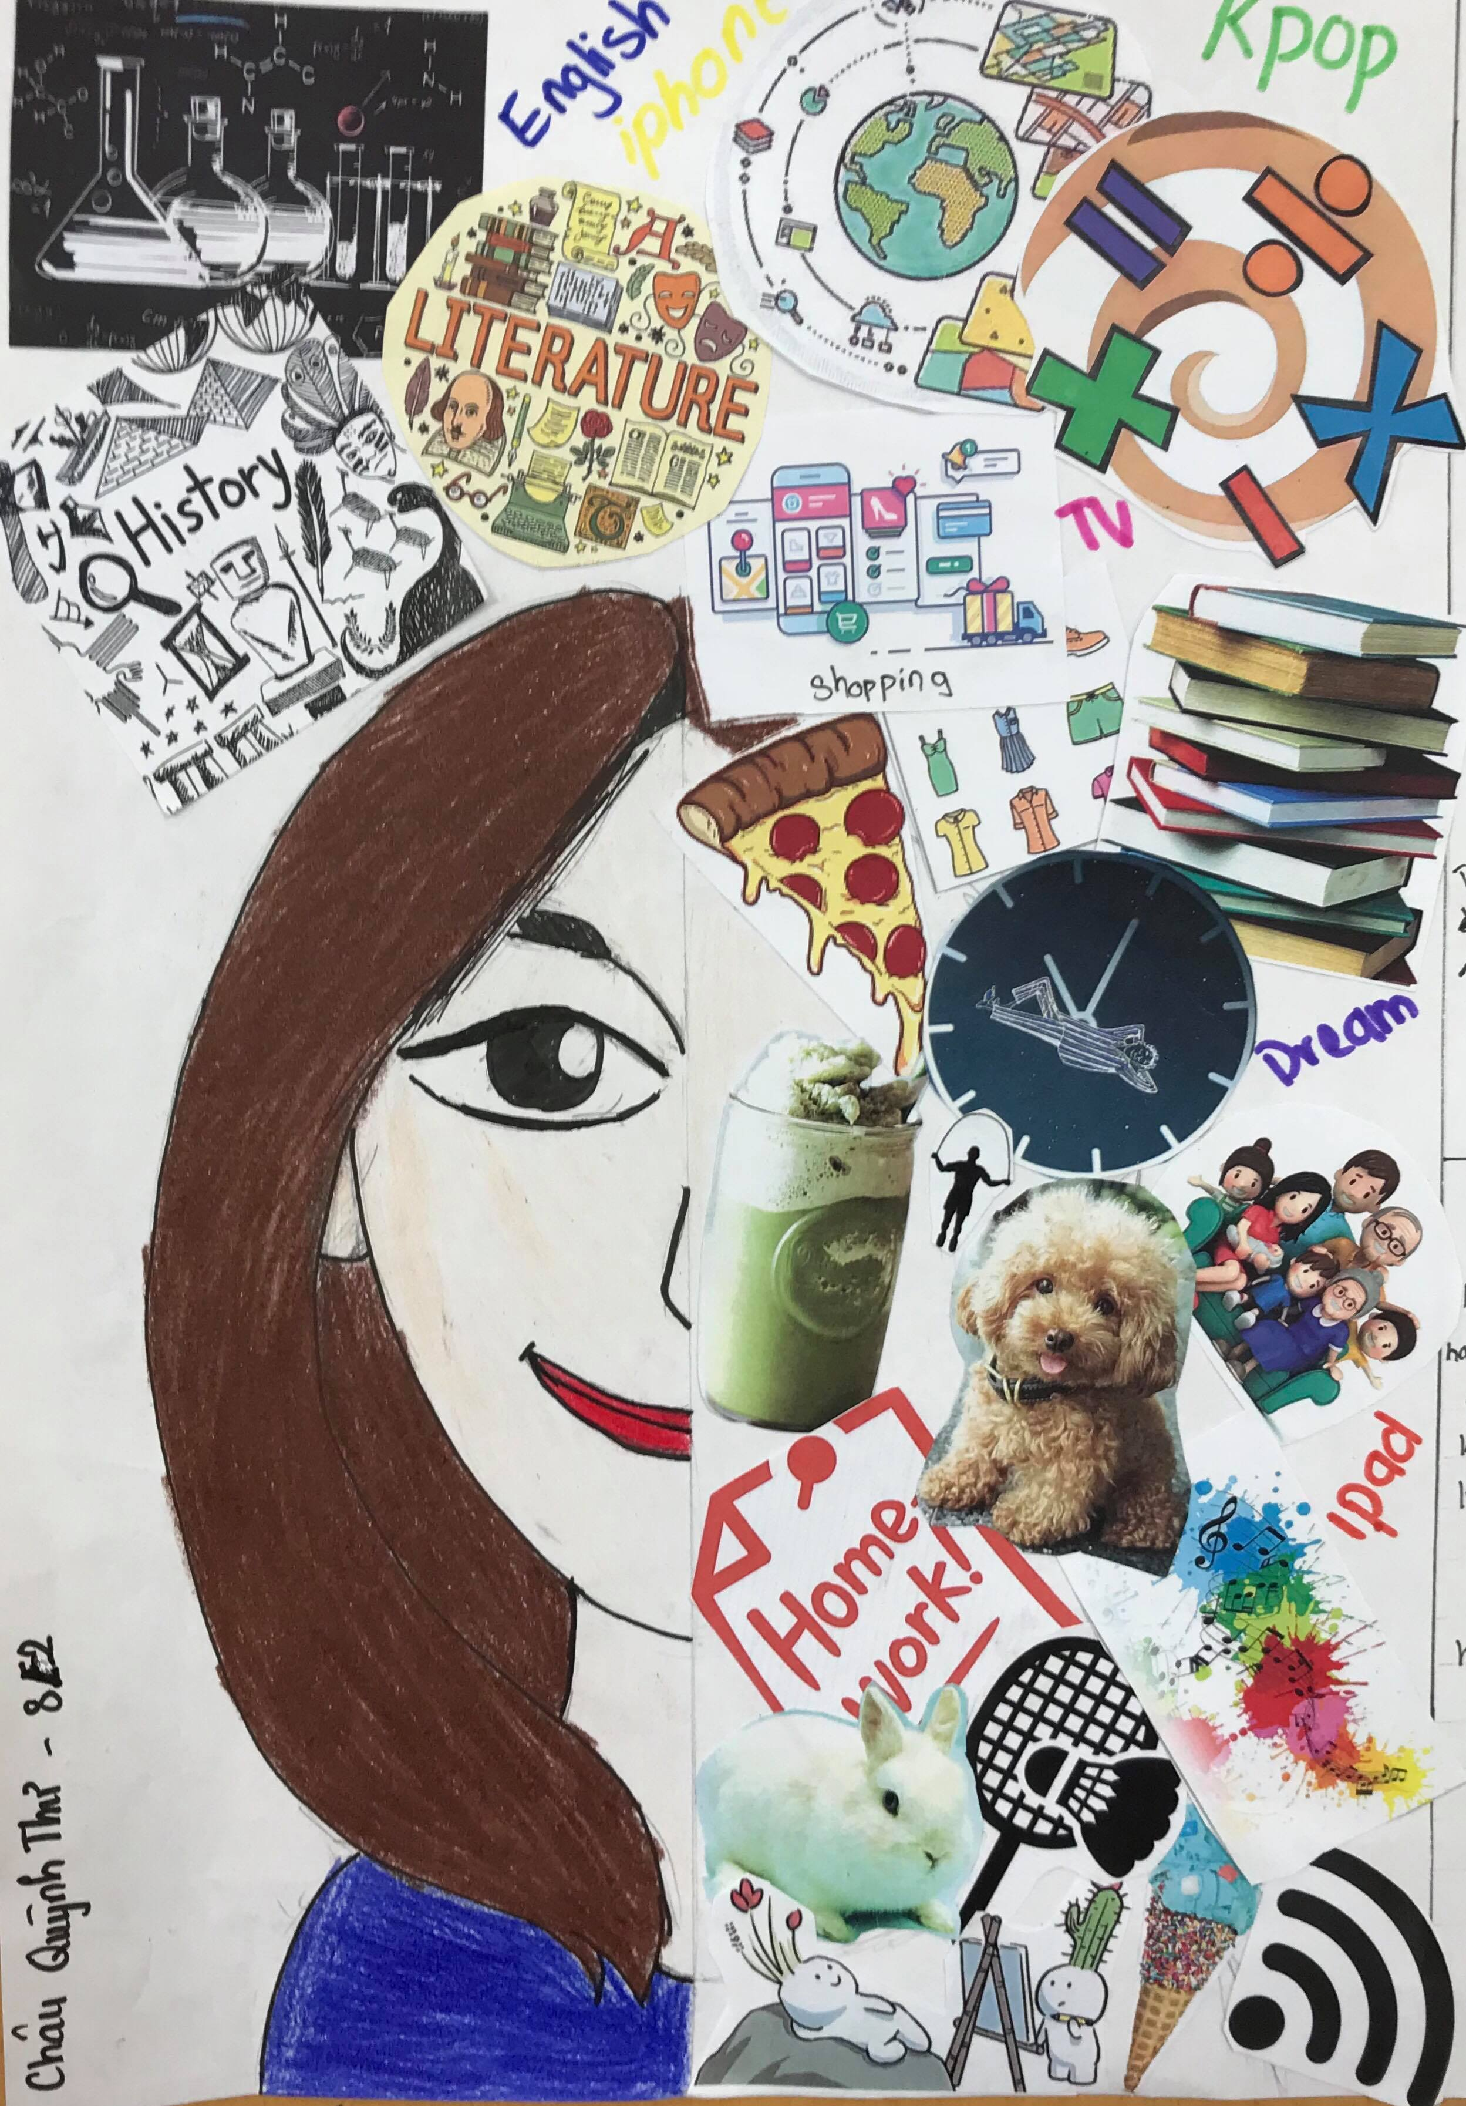
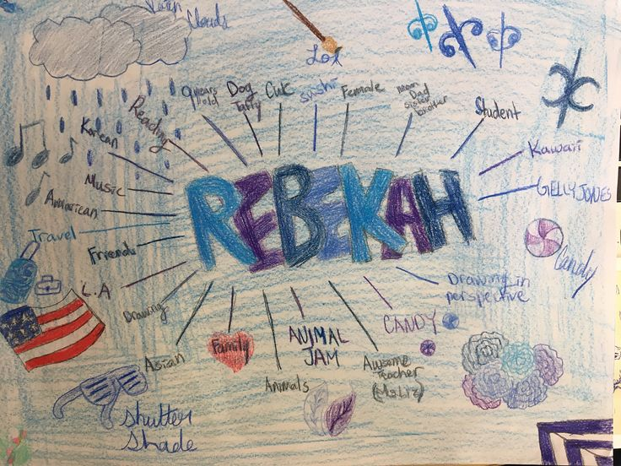
EXPLORING IDENTITY: CLASSROOM ACTIVITY IDEAS
www.8ways.online/your-identity-map
https://malat-webspace.royalroads.ca/rru0053/my-digital-identity-map/
https://englishteaching101.com/self-portrait-ideas-esl/

Slide 7
ART-MAKING
WORK ORDER
Written steps
*Printed copy for each student and digital copy projected on whiteboard

Slide 8
STEPS TO CREATE:
 | ACTIONS | MATERIALS
01 | Students mark with a pencil on the wooden base where they would like wire to be mounted from (2-3 base points) | Ruler Pencil & eraser Wooden base
02 | Students use dremel tool or drill to create holes in marked areas for wire to fit through. Tips: Ensure width of wire and drill bit are accurate for a tight fit into the hole. Hole should be deep enough into wood block (approx. halfway) so that it can be stable | Drill or Dremel tool Wooden base Safety glasses
03 | Students use pliers to cut and bend wire into desired sculptural shapes | Armature wire Pliers Wire cutter Wooden base Safety glasses Gloves

Slide 9
STEPS TO CREATE:
 | ACTIONS | MATERIALS
04 | Students insert wire into holes and continue shaping accordingly. Tips: Use hot glue on the base to help secure wire and seal top of hole | Armature wire Pliers Wooden base Gloves Hot glue gun
05 | Students tightly stretch the stocking over both the wire and the base. Attach the stocking to the bottom of the base with the stapler. Tips: Hot glue may be used if needed as a secondary attaching method. | Nylon stocking Wooden base Stapler Hot glue gun Fabric scissors
06 | Students cover the structure with plaster strips Tips: Ensure that the entire form is covered including the base Cut plastic strips beforehand and cover work surface with newspaper or table cloth | Work bench covering (eg newspaper) Plaster of Paris pre-cut strips Lukewarm water Bowl Art smock

Slide 10
STEPS TO CREATE:
 | ACTIONS | MATERIALS
07 | Once plaster has dried, student use sandpaper to smooth down surfaces/curves and shape the sculpture further to define edges Tips: Do this step outside if possible so plaster dust does not go everywhere | Sandpaper Art sketch for reference Safety glasses Safety mask Art smock
08 | Students prime the sculpture with emulsion or white acrylic paint or gesso. Tips: Use a hairdryer on low setting to speed up the drying time of paint base | Primer (Gesso, Emulsion, Acrylic) Paintbrushes Art smock Paint palette Hairdryer
09 | Students prime the sculpture with emulsion or white acrylic paint or gesso. Once primer is dried, students paint their designs over the sculpture with acrylic paint Tips: Start off with filling in background colours and main shapes and go in with the details afterwards | Paintbrushes Art smock Coloured acrylic paints Paint palette Water and water bowl

Slide 11
ART-MAKING
WORK ORDER
Visual steps
*Printed copy for each student and digital copy projected on whiteboard

Slide 12
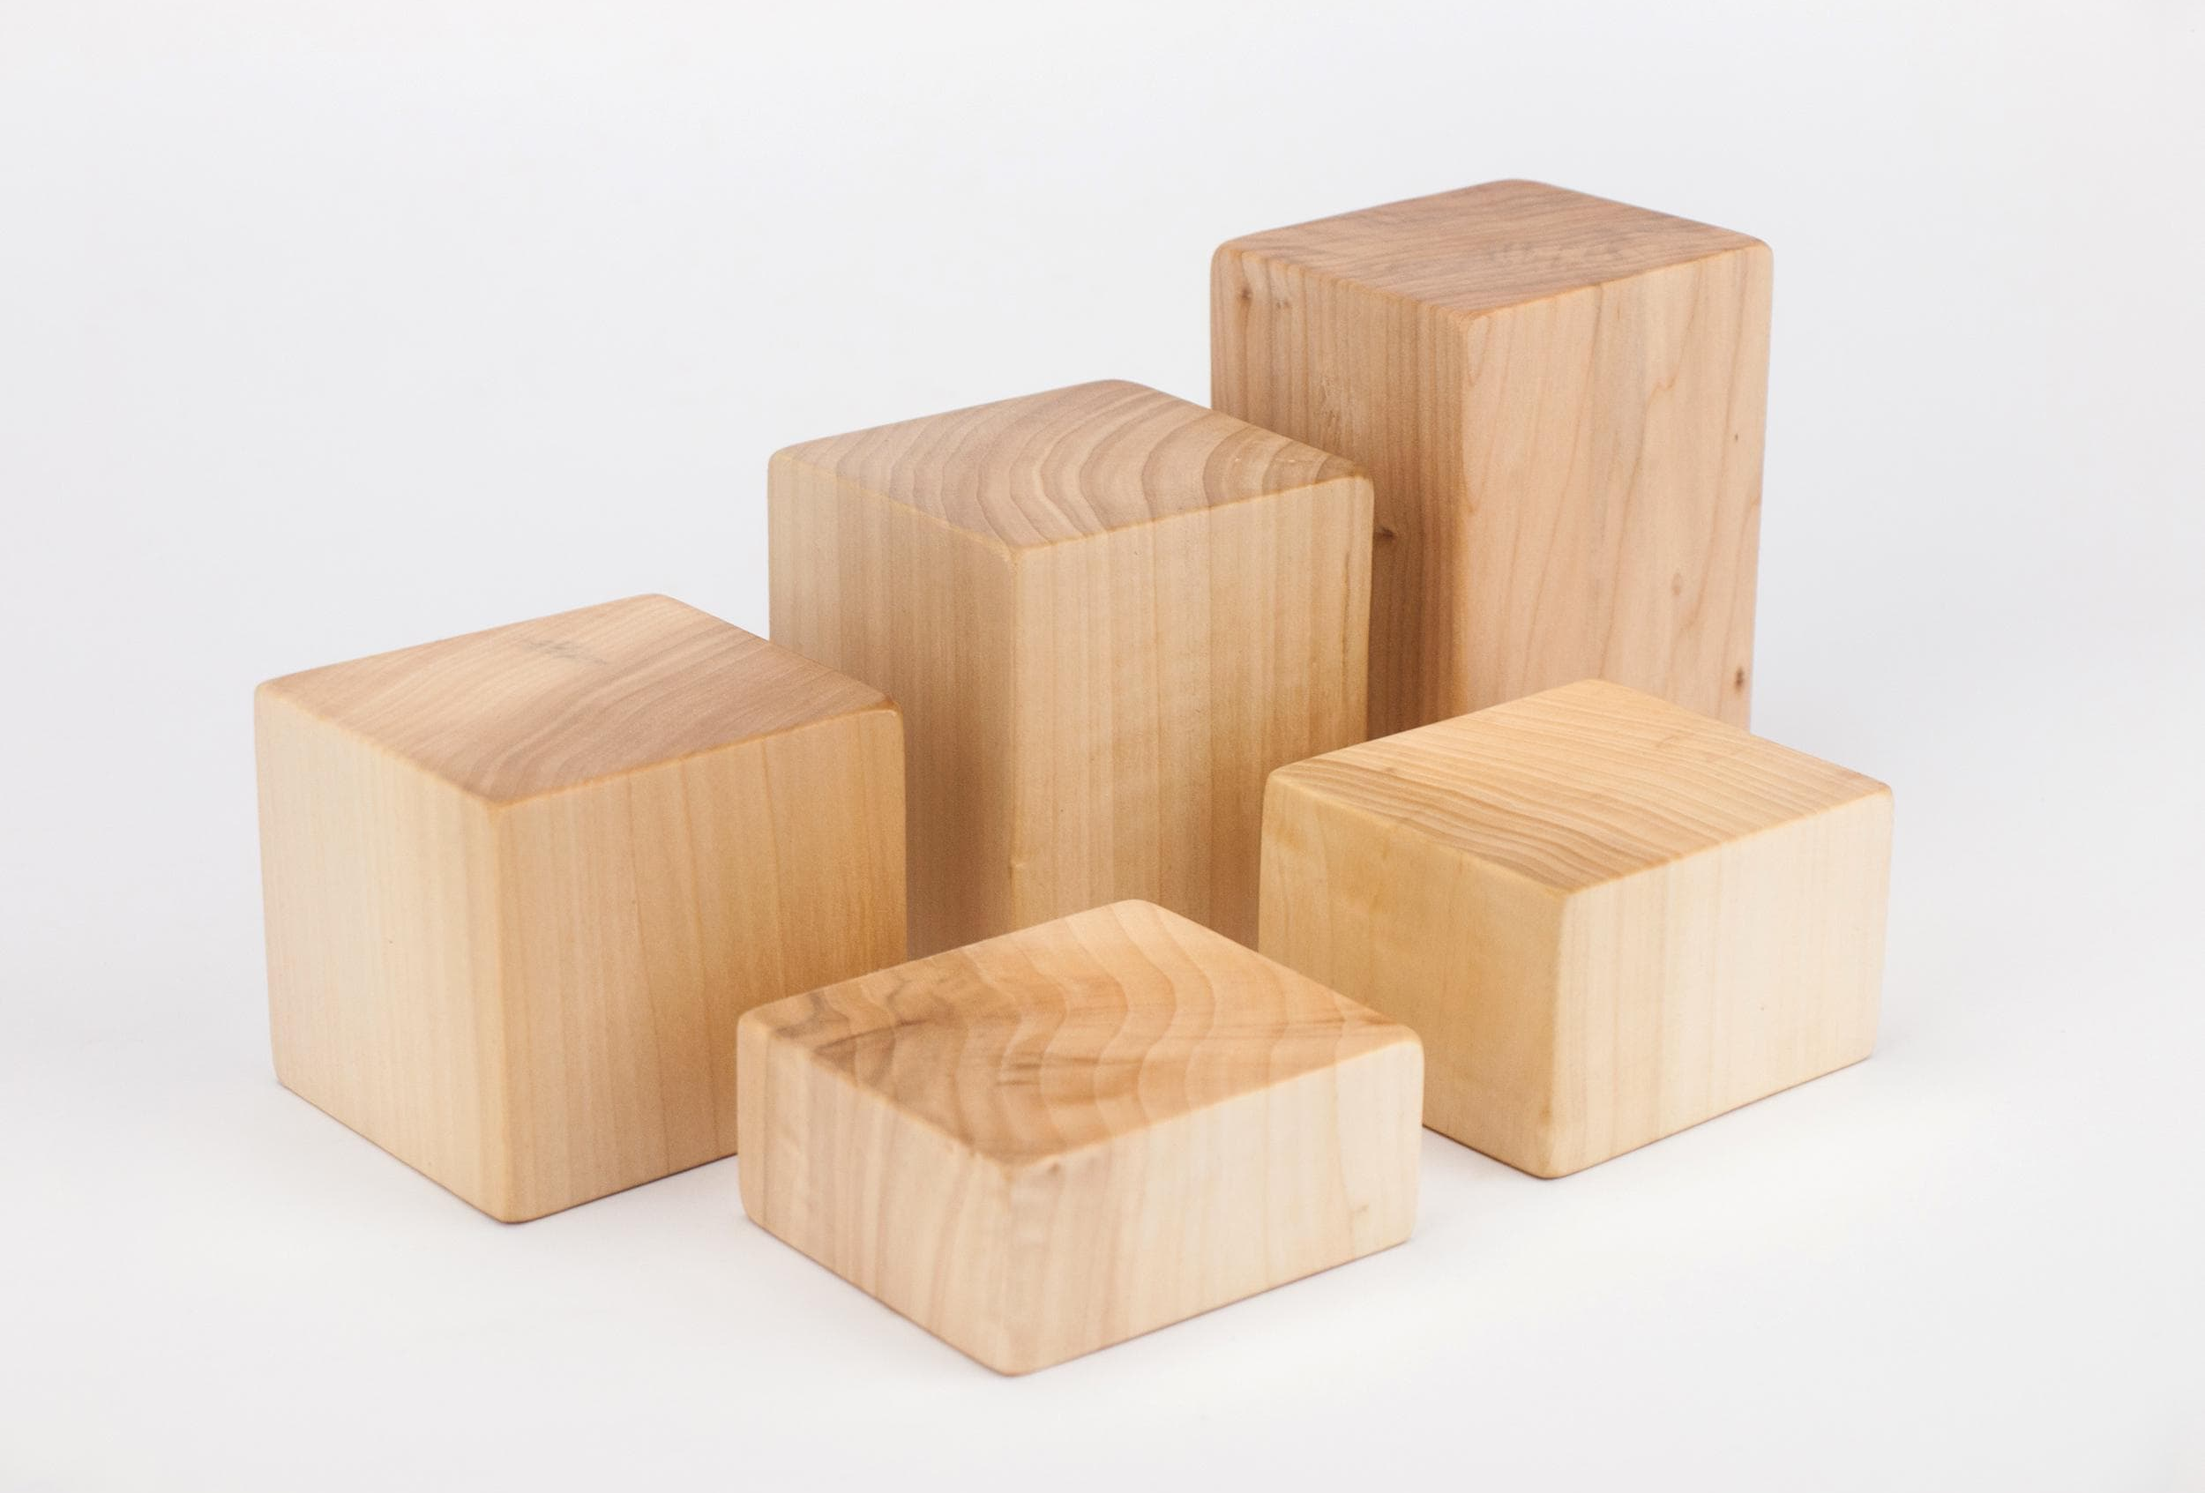
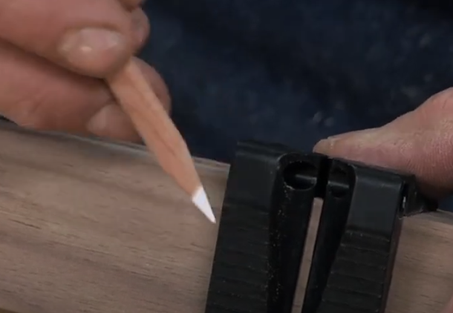
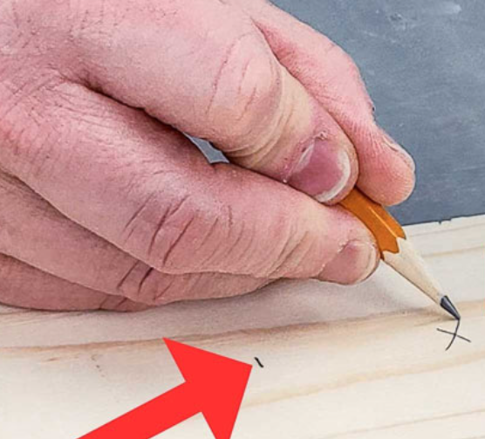
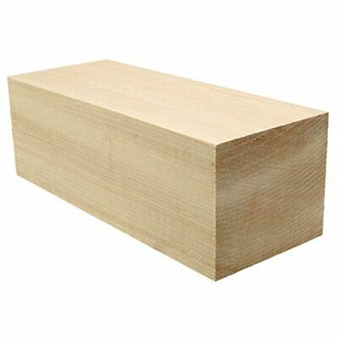
01
https://sawsonskates.com/how-to-measure-and-cut-wood-accurately

Slide 13
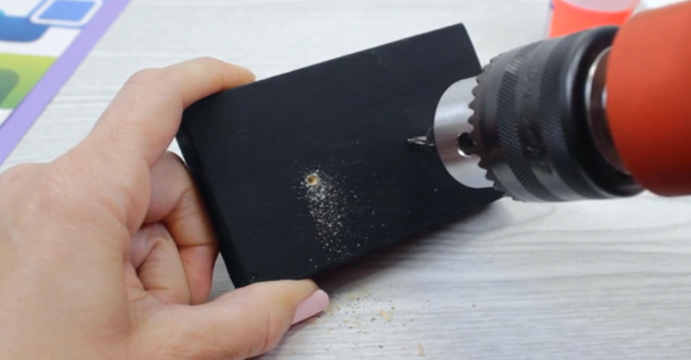
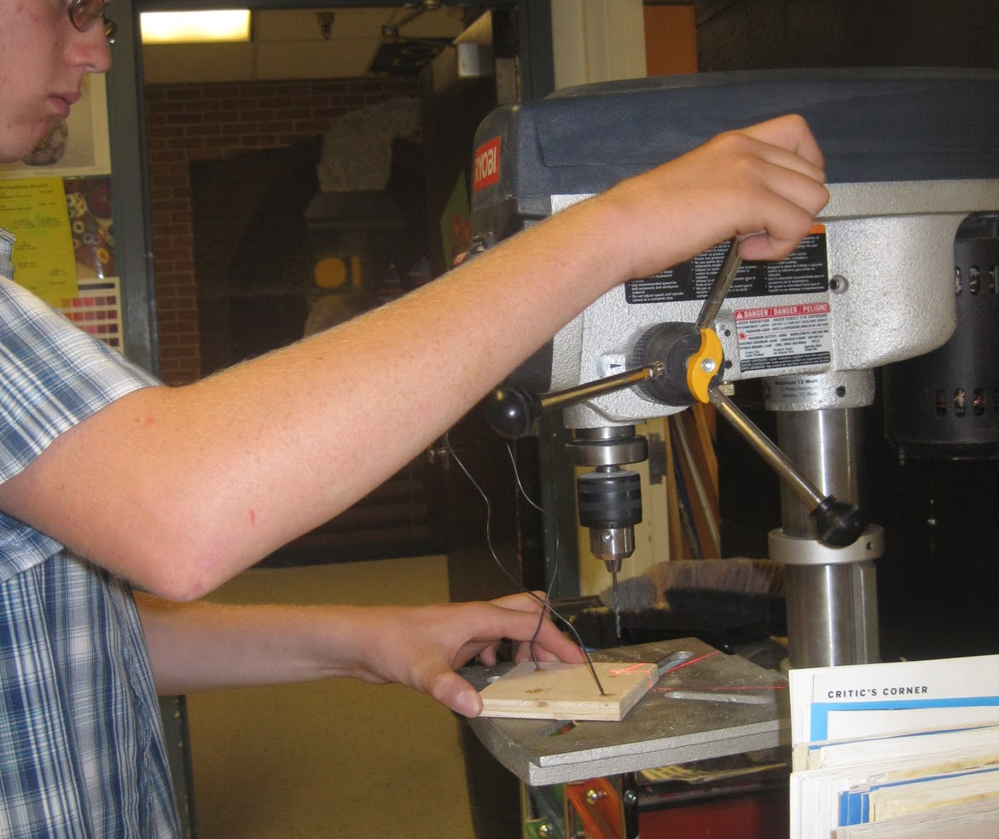
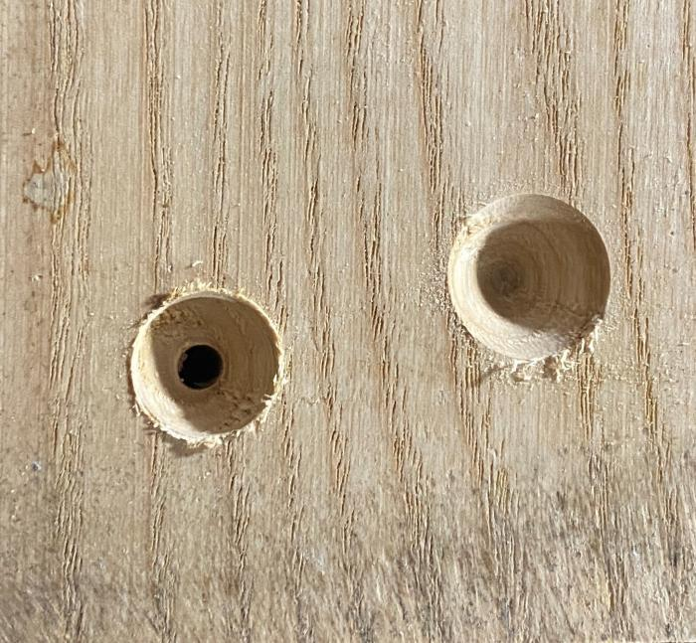
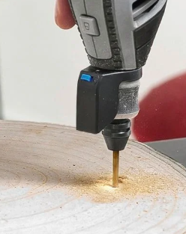
02
https://www.bunnings.com.au/dremel-4v-7760-lite-cordless-rotary-tool-kit_p0191737
https://artwarriorstsjh.blogspot.com/2011_10_01_archive.html
https://toolsforworkingwood.com/store/blog/1274

Slide 14
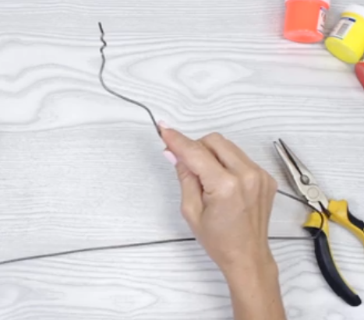
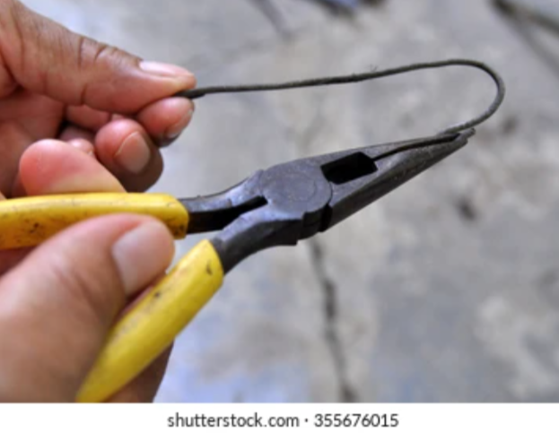
03
How-to Form, Bend, Manipulate, Shape, Break, Straighten, Lash or Connect Wire Tutorial
https://www.wikihow.com/Make-a-Panty-Hose-Sculpture

Slide 15
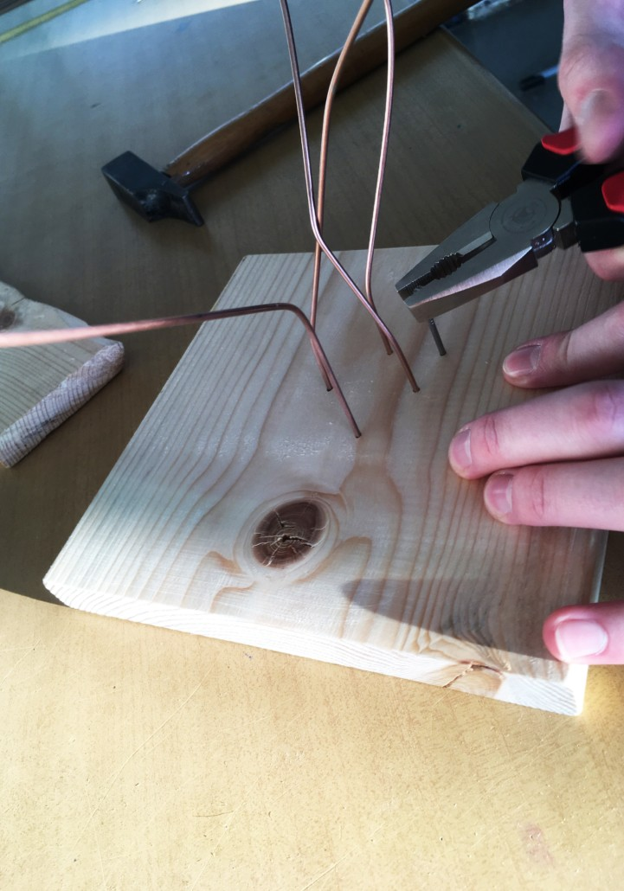
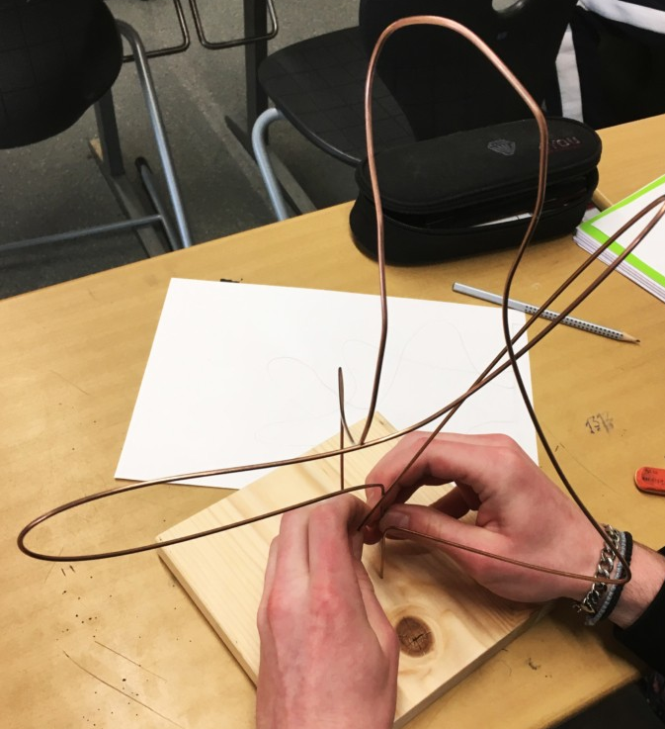
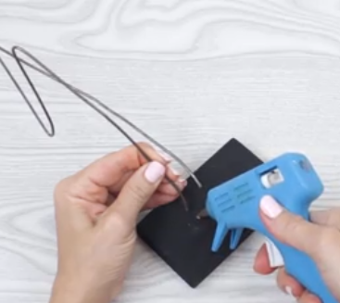
04
https://www.wikihow.com/Make-a-Panty-Hose-Sculpture

Slide 16
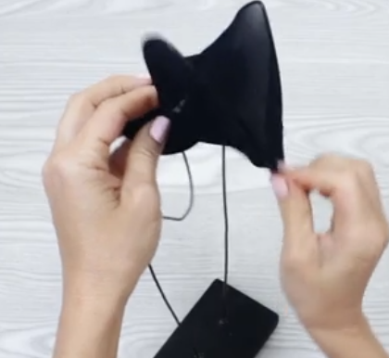
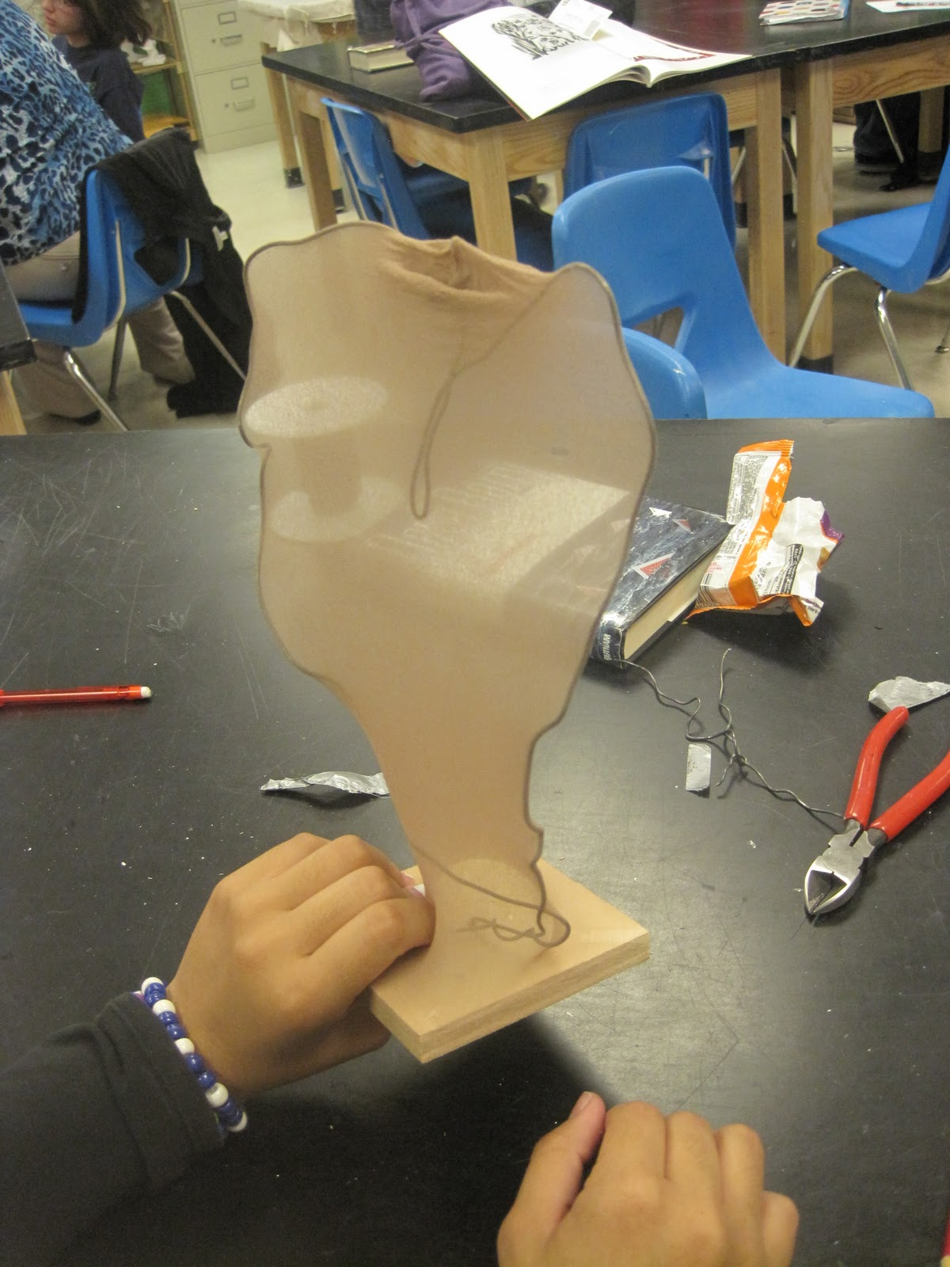
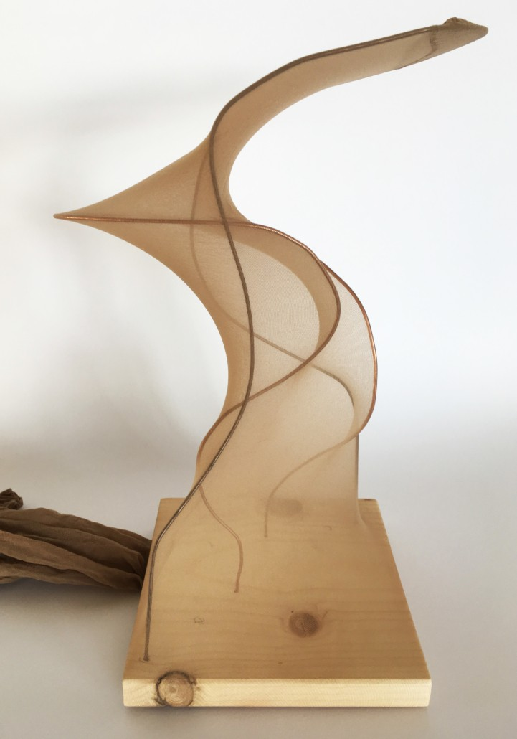
05
https://www.wikihow.com/Make-a-Panty-Hose-Sculpture
https://artwarriorstsjh.blogspot.com/2011_10_01_archive.html
https://kunstunterricht-ideen.de/ideen/abstrakte-gipsplastiken/

Slide 17
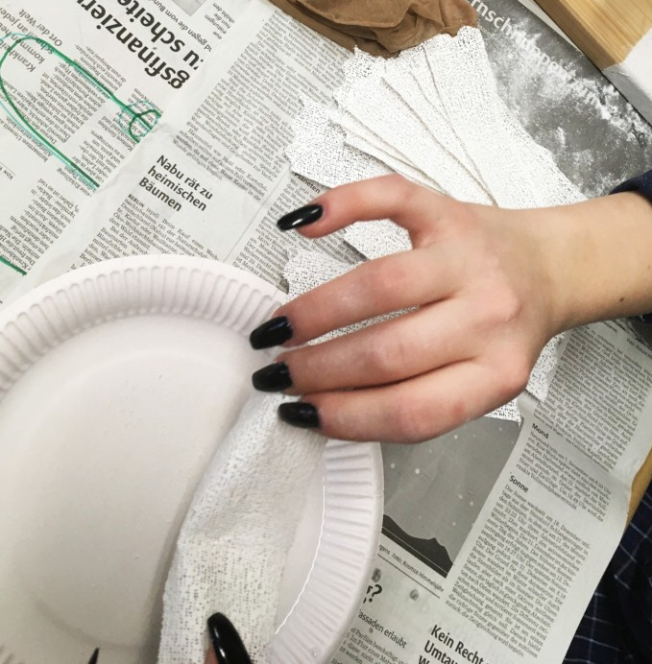
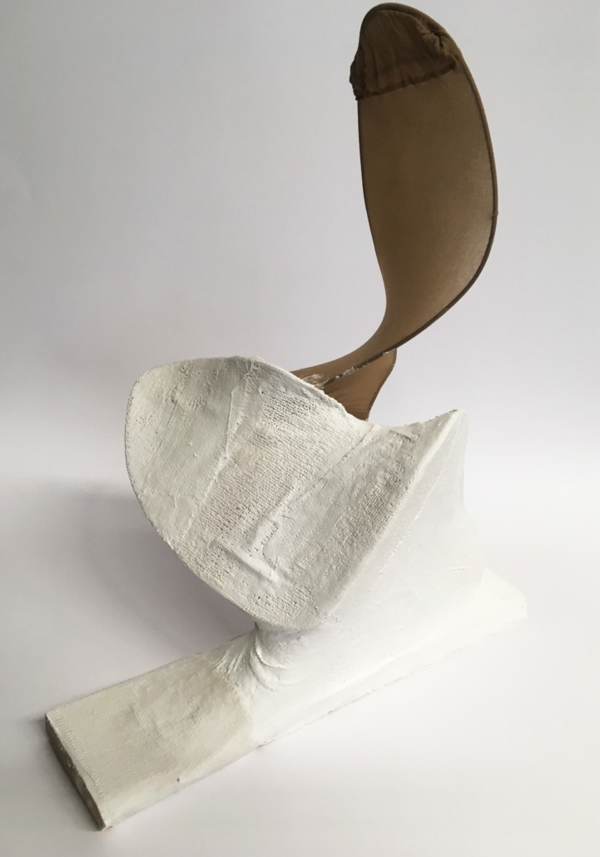
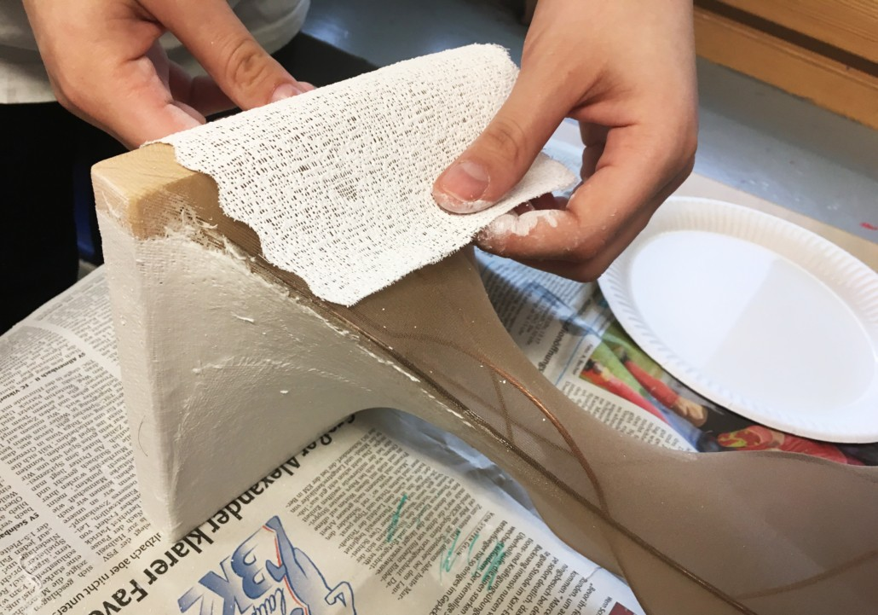
06
https://kunstunterricht-ideen.de/ideen/abstrakte-gipsplastiken/

Slide 18
07

Slide 19
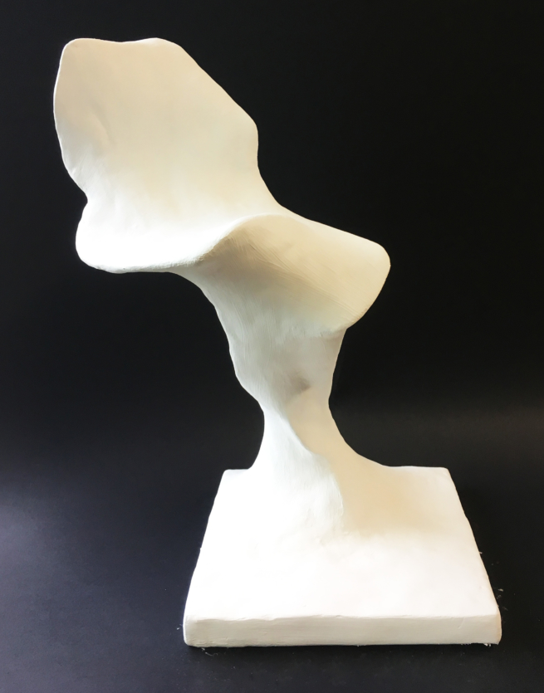
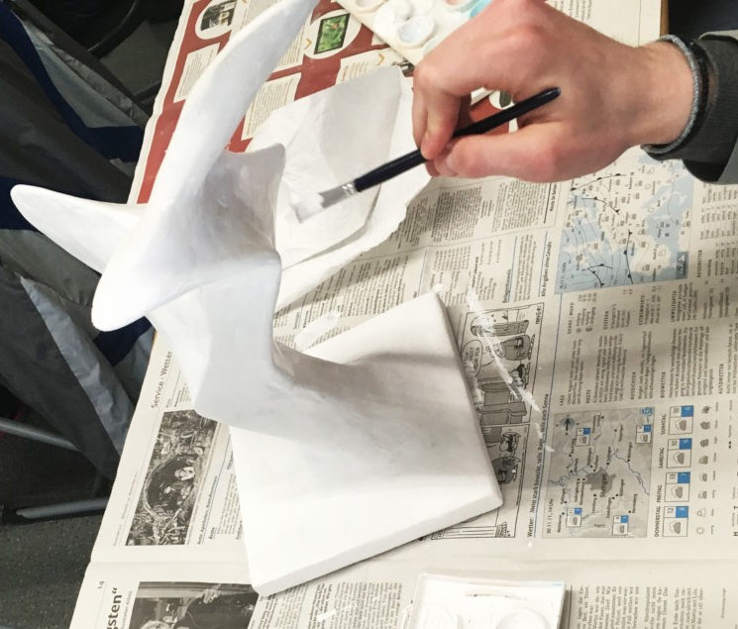
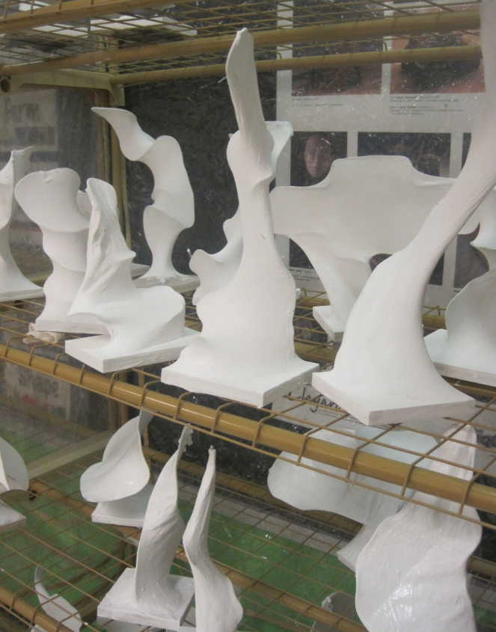
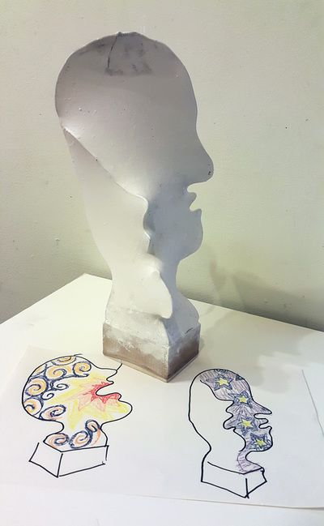
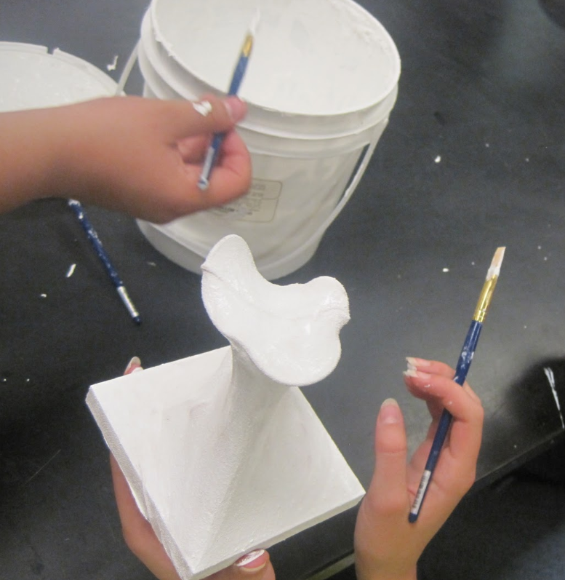
08
https://kunstunterricht-ideen.de/ideen/abstrakte-gipsplastiken/
https://artwarriorstsjh.blogspot.com/2011_10_01_archive.html

Slide 20
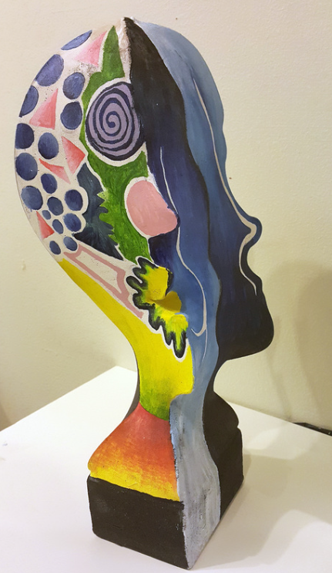
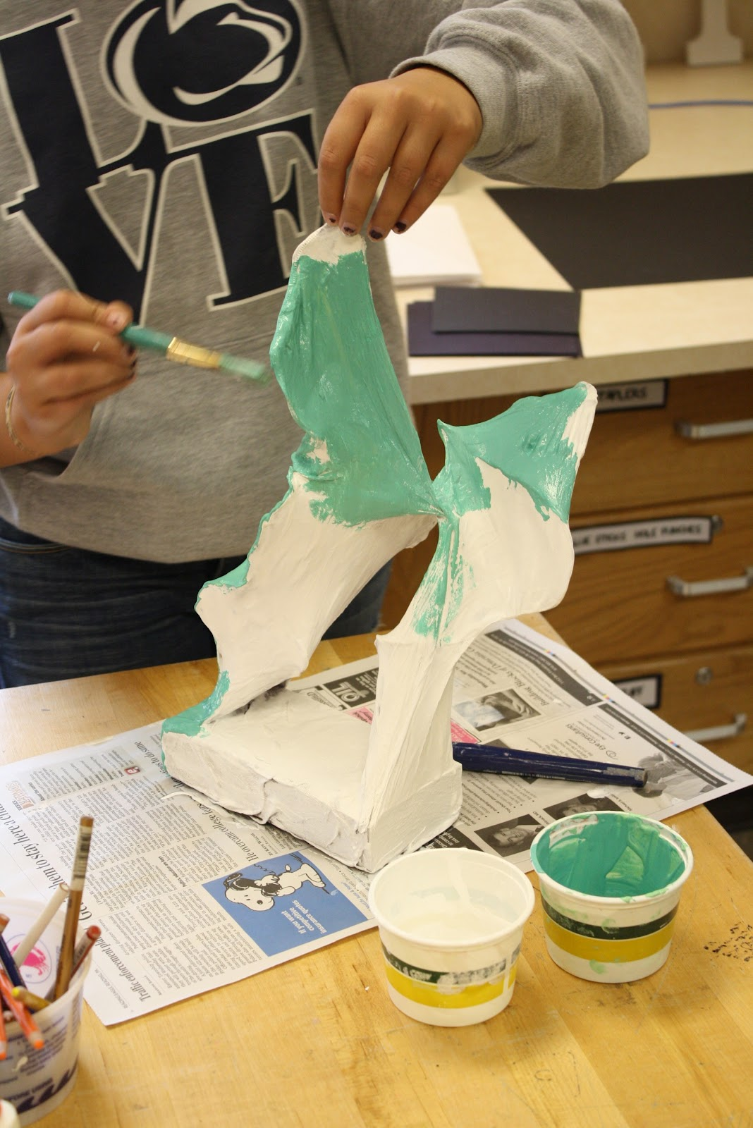
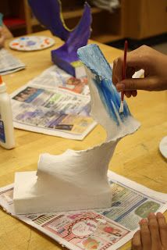
09
https://dalimoustache.blogspot.com/2012/09/wire-and-panty-hose-sculptures.html

Slide 21
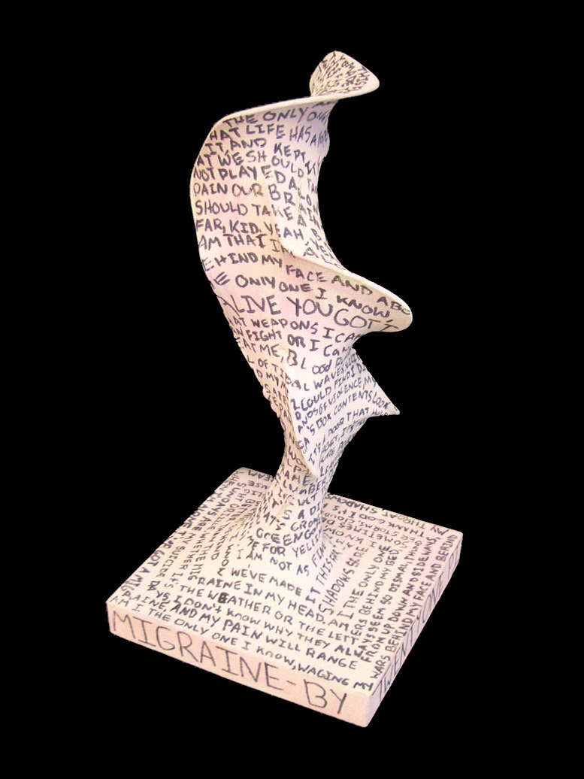
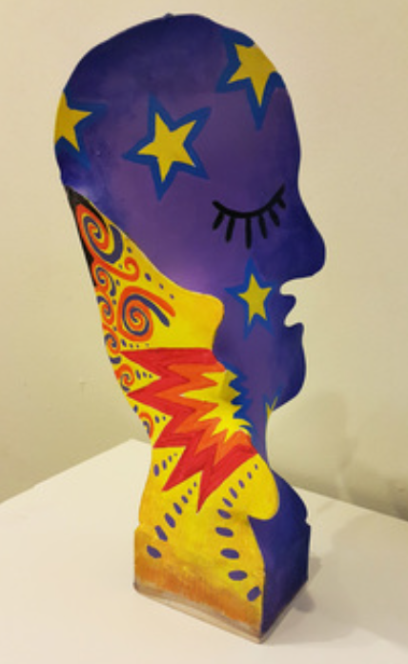
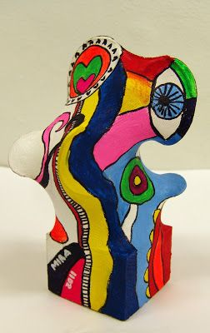
EXAMPLES OF STUDENT FINISHED OUTCOMES
https://au.pinterest.com/pin/6685099439912722/
www.linefroeslev.dk
https://www.artedguru.com/3d-projects.html

Slide 22
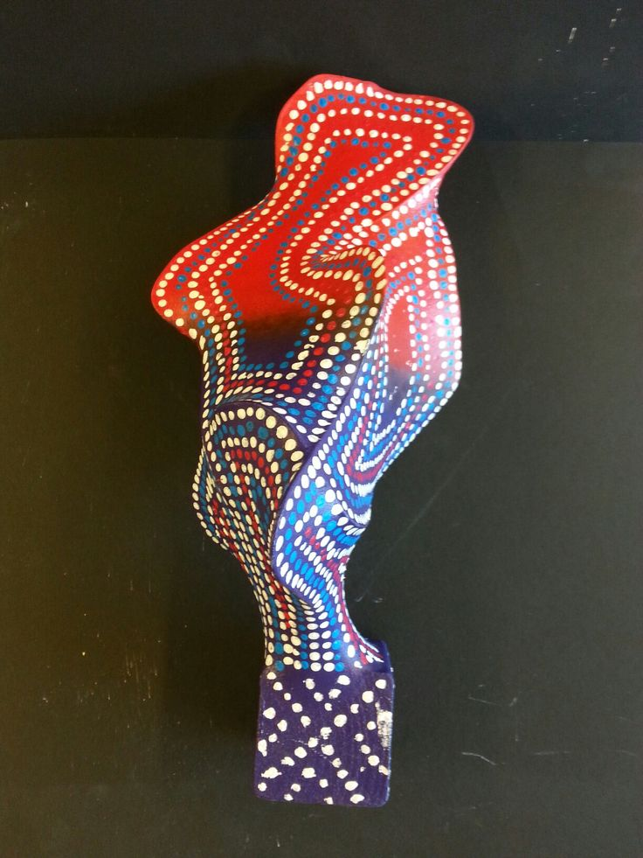
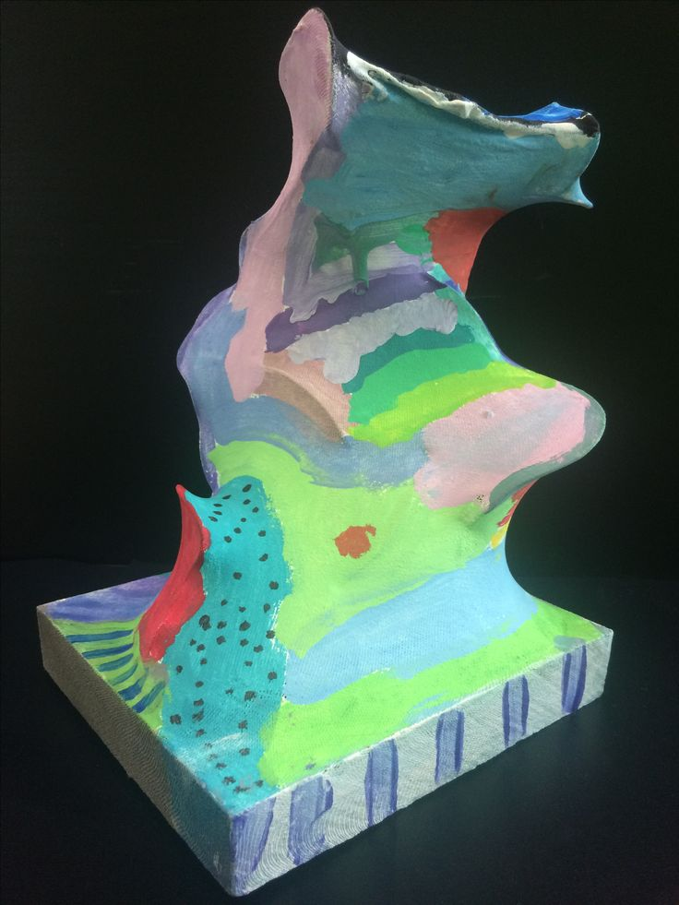
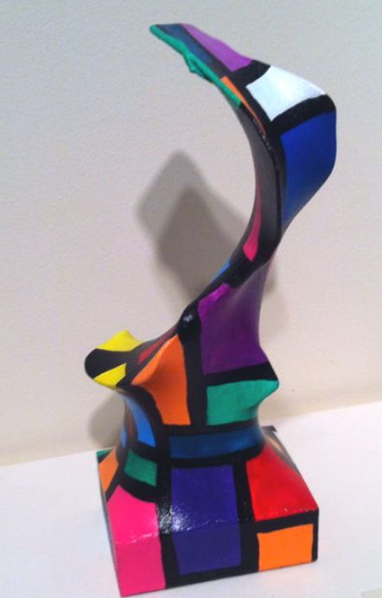
EXAMPLES OF STUDENT FINISHED OUTCOMES
https://au.pinterest.com/pin/41447259074810291/
https://au.pinterest.com/pin/211174952392472/
https://au.pinterest.com/pin/124763852169062380/

Slide 23
RESOURCES
EXPLORING & RESPONDING:
Brief history of abstract sculpture
PZ's Thinking Routines Toolbox
DEVELOPING PRACTICES & SKILLS:
Studio Habits of Mind examples
What is creative collaboration?
CREATING & MAKING :
How to make a pantyhose sculpture
How to use plaster cloth
LOG ONTO THE
TEACHER LEARNING
HUB FOR MORE!

Slide 24
HAPPY TEACHING !

