Slide 1
VCE Art Creative Practice 2023-2027
Unit 2
Implementation

Slide 2
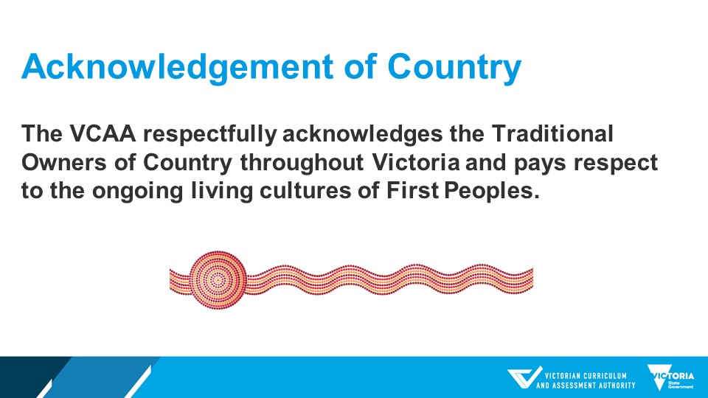

Slide 3
VCE Art Creative Practice – Unit 2
Outline
Features of Unit 2 VCE Art Creative Practice
Overview of the areas of study
Teaching ideas
Assessment ideas

Slide 4
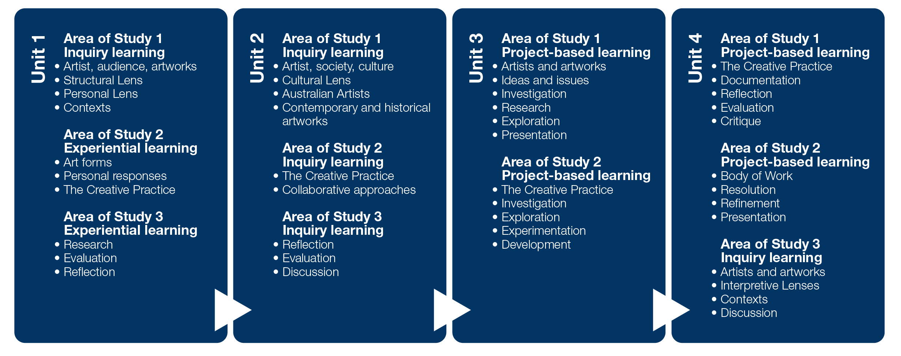
VCE Art Creative Practice:
Study specifications
Inquiry learning
Experiential learning
Project based learning

Slide 5
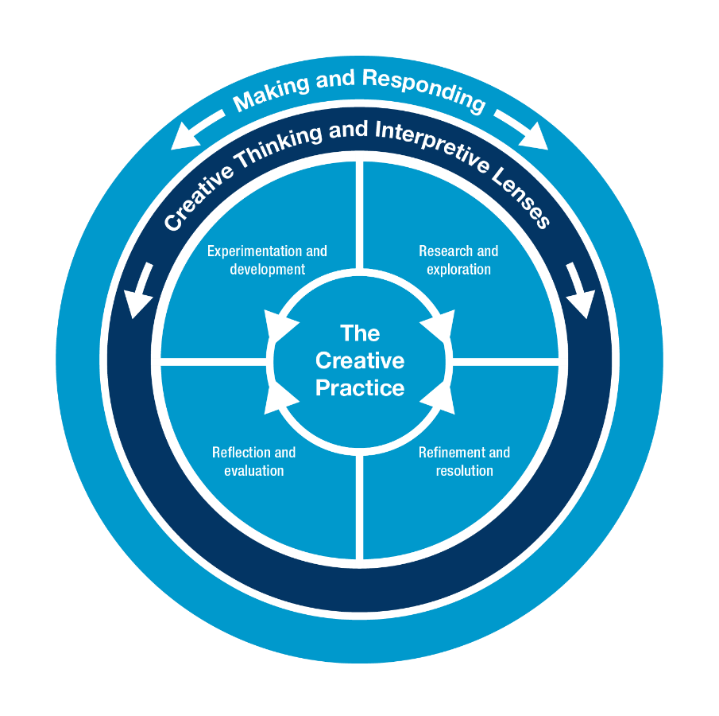
VCE Art Creative Practice
Study specifications: The Creative Practice
research and investigation
experimentation and development
refinement and resolution
reflection and evaluation.
Inquiry learning
Experiential learning
Project based learning

Slide 6
The Creative Practice
Research and exploration
The research and exploration component of the Creative Practice includes:
researching and exploring ideas based on experiences, observations and personal interest
researching and exploring materials, techniques and processes in art forms to respond to personal, cultural and social influences and ideas
researching and examining personal, cultural, historical and social influences that inform the exploration and development of artworks
exploring, analysing and interpreting influences and ideas in artworks using the Interpretive Lenses
exploring, analysing and evaluating how artists use visual language to communicate personal, cultural and social influences, ideas, beliefs and values.

Slide 7
The Creative Practice
Experimentation and development
The experimentation and development component of the Creative Practice includes:
experimenting with materials, techniques and processes to develop artworks
experimenting with personal ideas and responses
experimenting with the influences of ideas, values and beliefs to develop artworks
developing ideas in artworks through experimentation and exploration
developing knowledge of art elements and art principles through experimentation and exploration to create visual language
developing points of view and interpretations of the meanings and messages of artworks in different contexts using the Interpretive Lenses
developing artworks in response to the research and exploration of and experimentation with visual language.

Slide 8
The Creative Practice
Reflection and evaluation
The reflection and evaluation component of the Creative Practice includes:
analysing and evaluating artworks using the appropriate Interpretive Lenses
analysing and evaluating the application of materials, techniques and processes to resolve ideas in artworks using the Interpretive Lenses
critically analysing and evaluating how the symbolic values and beliefs of people, places and objects are assigned by artists and viewers or audiences
analysing and evaluating how visual language can communicate ideas and meaning in artworks
reflecting, analysing and evaluating using critique and feedback.

Slide 9
The Creative Practice
Refinement and resolution
resolving ideas and visual language in artworks
resolving points of view and interpretations of the meanings and messages of artworks, using critical judgment and the Interpretive Lenses
realising and refining artworks through the selection and manipulation of materials, techniques and processes
refining the use of visual language to communicate ideas and meaning in artworks
refining technical skill in the use of materials, techniques and processes in art forms to communicate ideas and meaning in artworks
considering the presentation and display of artworks in different contexts to communicate ideas and meaning.

Slide 10
VCE Art Creative Practice
Study specifications: Interpretive Lenses
Through Making and Responding
Structural Lens
Personal Lens
Cultural Lens
The Structural Lens informs the analysis and interpretation of an artwork, and its relationship with the artist and viewer or audience, through the investigation of the use of art elements and art principles, and the application of materials, techniques and processes. It also considers the stylistic qualities and symbolism evident in the artwork, and the context in which artists work and in which artworks are presented or viewed.
The Personal Lens informs the analysis and interpretation of an artwork through the investigation of the personal feelings, beliefs and life experiences of the artist, viewer or audience.
The Cultural Lens informs the analysis and interpretation of an artwork through the investigation of social, historical and cultural influences and representations.

Slide 11
VCE Art Creative Practice
Study specifications: Study Terms
Art elements
Art principles
Art forms
Contexts
Critique
Influences and inspiration
Visual language
Body of Work
Contemporary artists and artworks

Slide 12
VCE Art Creative Practice
Big Planning Ideas
Inspiration
A core focus of VCE Art Creative Practice is the place of the student artist in the world continuum of artmaking. The connection of the student to historical and contemporary art is crucial and students must be supported to regularly refer to the work of other artists and sources of inspiration.
Selecting artworks for study
Students should be encouraged to view artworks from a broad range of periods and cultures and experiment with a wide range of materials, techniques and processes. The study encourages teachers to take their students out of the classroom environment and inform their art making through visits to galleries and studios, and through experience working with practising artists, curators, critics and art historians.

Slide 13
Big planning ideas
VCE Art Creative Practice
Selecting artists for study
Select artists for whom there is sufficient background information, so the inquiry can be deep and broad.
Investigate the origins of the artist’s practice more broadly and research the ideas and issues they represent in their work.
Investigate the intention of the artist for the presentation of the work and for whom it is intended and why.

Slide 14
Big planning ideas
VCE Art Creative Practice
Art Forms
VCE Art Creative Practice introduces students to a range of artists practice and artworks.
It is important that in students engage with a range of art forms across Units 1 to 4. A list of art forms is on page 17 of the VCE Art Creative Practice study design along with a definition of materials, techniques and processes.
Students must understand the specific use of materials, techniques and processes associated with the art form that is selected.
Teachers should aim to expose students to a diverse range of art forms and how visual language is created by artists working in a specific art form.

Slide 15
Big planning ideas
VCE Art Creative Practice
In Unit 2 Area of Study 1 students select three artists to research from different periods of time and cultures including contemporary artists and Aboriginal and Torres Strait Islander artists.
The selection of these artists for study could inform the artforms the students explore in collaborative practice in Unit 2 Area of Study 2.
In Unit 2 Area of Study 2 students study approaches to collaborative practice. Students work should work in an art form that encourages collaboration such as contemporary art practice.
Contemporary art practice is often conceptual so students may be research art forms that are multidisciplinary.

Slide 16
The Visual diary
VCE Art Creative Practice
A visual diary is used to record and document making and responding in Creative Practice. Students should be encouraged to use formats that suit their working method and the body of work that they are producing.
Visual Arts diary form
document boxes
Sketchbooks
bound or clipped together sheets, or portfolios
digital formats for their visual diary such as an online repository.
Visual Arts diary content
Annotations
Visual material
Audio recordings
Documentation that is numbered and dated

Slide 17
VCE Art Creative Practice
Unit 2: Interpreting artworks and developing the Creative Practice
Inquiry learning
Explore collaborative practice, historical and contemporary contexts
Visual responses exploring collaborative practice, historical and contemporary contexts
Use of the Creative Practice and collaboration to make and present artworks
Understand the Cultural Lens
Area of Study | Outcome
Area of Study 1 The artist, society and culture | On completion of this unit the student should be able to use the Cultural Lens, and the other Interpretive Lenses as appropriate, to analyse and compare the practices of artists and artworks from different cultures and times.
Area of Study 2 The collaborative Creative Practice | On completion of this unit the student should be able to use the Creative Practice to explore social and cultural ideas or issues to make and present at least one finished artwork using collaborative approaches.
Area of Study 3 Documentation of collaboration using the Creative Practice | On completion of this unit the student should be able to critically reflect on, evaluate and document their use of the Creative Practice to develop and make collaborative visual responses.

Slide 18
VCE Art Creative Practice – Unit 2
Area of Study 1: The artist, society and culture
Outcome 1 | On completion of this unit the student should be able to use the Cultural Lens, and the other Interpretive Lenses as appropriate, to analyse and compare the practices of artists and artworks from different cultures and times.
Learning structure | Guiding questions What is the role and purpose of art in societies? How do artworks reflect cultural and personal values and beliefs? What is collaborative artistic practice? How do contemporary artists represent ideas in their work? What are the differences between contemporary and historical art practice? What components of the Creative Practice do I use in my investigation? What aspects of the Cultural Lens will I use to analyse and interpret artworks? What artists will I investigate? (Refer to the list of artists on page 23 of the Art Creative Practice study design)

Slide 19
VCE Art Creative Practice – Unit 2
Area of Study 1: The artist, society and culture | Unit 1:
Key knowledge | the role and purpose of art in different cultural contexts and times the use of relevant aspects of the Cultural Lens to analyse and interpret artworks the use, as appropriate, of relevant aspects of the Structural Lens and the Personal Lens to analyse and interpret artworks diverse and alternative approaches to making and presenting artworks methods of making and presenting artworks in different historical and contemporary cultural contexts how artworks reflect the beliefs, values and traditions of different cultures the different ways that artists collaborate to make artworks the practices of artists from different periods of time and cultures referencing to support the analysis, evaluation and interpretation of artworks art terminology used in the analysis, evaluation and comparison of artworks and the practices of artists

Slide 20
VCE Art Creative Practice – Unit 2
Area of Study 1: Artists, artworks and audiences | Unit 1:
Key skills | apply the Cultural Lens to analyse and interpret artworks from different cultures and times apply, as appropriate, relevant aspects of the Structural Lens and the Personal Lens to analyse and interpret artworks compare artworks from different cultural and historical contexts analyse diverse and alternative approaches to making and presenting artworks analyse methods of making and presenting artworks in historical and contemporary cultural contexts analyse how artworks can reflect the beliefs, values and traditions of different cultures investigate the different ways that artists collaborate to make artworks evaluate and compare the practices of artists from different periods of time and cultures use references to artworks to support analysis, evaluation and interpretation use appropriate art terminology to analyse, evaluate and compare the practices of artists and artworks

Slide 21
Inquiry learning activities
VCE Art Creative Practice – Unit 2 Area of Study 1
In Unit 2 Area of Study 1 students investigate the context of artworks and how values, beliefs and traditions of societies are reflected in artworks.
The inquiry can be also structured on a question that links the artists that are selected from the list on page 23 of the study design. The focus is on the artists’ use of materials, techniques and processes.
The focus in this Area of Study is on how artists collaborate with each other. Students could use the concept of collaboration as the focus for their inquiry. They could use critical and creative thinking to investigate the relationships the artists have in their practice and how viewpoints and ideas, that are often disparate, are combined in to make artworks.
Students are also required to investigate the making and presentation of artworks so they can conduct an open ended inquiry using the artwork as a starting point. They can investigate the relationships between the context of the work (where it was made and produced) and where it is viewed. The context may have an influence over how the work is interpreted and the direction of the inquiry the student will undertake.

Slide 22
Teaching and Learning Ideas
VCE Art Creative Practice – Unit 2 Area of Study 1
Students use the Cultural lens and compare artists practices, meanings and messages.
Create a mind map on ‘My Culture’ including technology, leisure, food, celebration, sport or religion.
Influence of artistic collaborations impact on other artists.
Technical assistants collaborating with artists Cindy Sherman and Patricia Piccinini
Cahun and Moore’s collaborations – Claude Cahun and Marcel Moore
Comparison of the practices of May Morris, Sally Smart and Yinka Shonibare who collaborate with craftspeople to realise their ideas.
Theme: Football.
Artists Vincent Namatjira, Pitcha Making Fellas and the Hermannsburg potters, all of whom are Aboriginal and Torres Strait Islander artists and work with Australian Rules Football.

Slide 23
Detailed learning example 1
VCE Art Creative Practice – Unit 2 Area of Study 1
Scaffold
Collect artists information
Make dot points – for description and comparison of artworks, materials, methods/collaboration.
Make dot points using the Interpretive Lenses questions
Create and present response
Interpretive Lenses Questions
How has each artist used their artworks as a vehicle to invite change and provoke conversation?
How has each artist worked in collaboration? Do they work specifically with someone? How?
How do each artists methods differ? Is the era relevant to the way they work?
What is significant culturally to the way the artist works?

Slide 24
Detailed learning example 1
VCE Art Creative Practice – Unit 2 Area of Study 1
May Morris 1862 – 1938. English.
Technique/Medium: Fabric
Subject matter: English Flora
Practice: Textile and embroidery
Collaboration: Artisans, Morris & Co, England
Yinka Shonibare 1962 - British – Nigerian.
Technique/Medium: Mixed media, fabric installations
Collaboration: Artisan, Fabric Workshop and Museum, Philadelphia (FWM), USA
Subject matter: Cultural identity, colonialism, post colonialism
Practice: Large scale mixed media installations
Sally Smart 1960 – Australian.
Fashion House - Marni, Italy
Subject matter: Identity, gender politics
Practice: Large scale assemblage installation with performance and video
Collaboration: Artisans, Dancers, filmakers

Slide 25
Detailed learning example 2
VCE Art Creative Practice – Unit 2 Area of Study 1
Analyse and compare how the lives of Aboriginal and Torres Strait Islander peoples are reflected in the work of Albert Namatjira, Emily Kgnwarreye and Joan Ross.
Albert Namatjira 1902 – 1959 Australia
Watercolour. Australian landscapes in a ‘western’ style connection to the land
Emily Kgnwarreye 1910 – 1996 Australian
Paintings and textiles. Traditional dreaming stories
Joan Ross (Date of Birth unknown) Scottish/Australian
Multimedia artist, assemblage and video. Colonialism in Australia, particularly its effect on indigenous Australians

Slide 26
Assessment
VCE Art Creative Practice – Unit 2 Area of Study 1
.
On completion of this unit the student should be able to use the Cultural Lens, and the other Interpretive Lenses as appropriate, to analyse and compare the practices of artists and artworks from different cultures and times.
Examples such as:
an extended written response
short-answer responses supported by visual references
an annotated visual report
a presentation using digital technologies such as an online presentation or interactive website
an oral presentation
The three artists selected for study must include:
an Aboriginal or Torres Strait Islander person
an artist who collaborates with other artists, technicians or with the viewer or audience as part of their practice
an artist from a historical period of time that has used at least one traditional art form and traditional materials and techniques
a contemporary artist whose practice is influenced by contemporary ideas, materials, techniques, processes or approaches.

Slide 27
Assessment Example
VCE Art Creative Practice – Unit 2 Area of Study 1
Table to scaffold task
 | Materials, Techniques and Processes | Signs and Symbols | Meanings and messages
Artist 1
Artist 2
Artist 3
Similarities
Differences

Slide 28
Assessment Example
VCE Art Creative Practice – Unit 2 Area of Study 1
Structural Lens
Compare the materials, techniques and processes used by the artist(s). Do they vary, according to the time and place that they were used?
Are there similarities or differences between the aesthetics of the works? Discuss.
Do the artists use symbols to communicate? How? Are there similarities or differences in the ways the artists do this?

Slide 29
Assessment Example
VCE Art Creative Practice – Unit 2 Area of Study 1
Personal Lens
Are there similarities between the lives of the artists? Is this reflected in their work? How?
Did the artist(s) work in isolation, or collaboratively? How has this influenced the work?
Does the artist(s) have specific beliefs that are relevant to the work?
Have the life experiences of the artist(s) influenced the work? How?
Do the specific beliefs of the audience affect their response to the works? How?
How would a contemporary audience have responded to each of the works?
How do you (the student) respond to each of the works? Are you drawn to one more than the others? Why?

Slide 30
Assessment Example
VCE Art Creative Practice – Unit 2 Area of Study 1
Cultural Lens
How have the time periods in which the artists worked influenced them? How is this evident?
Does a contemporary audience interpret the works differently to the original audience? Why?
Do the artists make work that responds to political events? How is this evident?
Do the artists subscribe to spiritual or philosophical ethos’? How is this explored in their work?
Have economics influenced the artists? Did their socio-economic situation influence their subject matter? Did they have access to materials, or have they used found or repurposed materials?
Has the work of the artists changed in financial value? How does this affect the interpretation of the work?
Does the ethnic background of the artists bring art practices and visual elements to the works?
Is the gender of the artists reflected in their work? How?
Do the artists ask their audiences to consider ethical issues?
Do the practices of the artists provoke shock or disgust? Why?
How do these factors contribute to engagement and communication of meaning?

Slide 31
VCE Art Creative Practice – Unit 2
Area of Study 2: The collaborative Creative Practice
Outcome 2 | On completion of this unit the student should be able to use the Creative Practice to explore social and cultural ideas or issues to make and present at least one finished artwork using collaborative approaches.
Learning structure | Guiding questions How are collaborative artworks developed? What are the processes used to make collaborative artworks? How do artists develop visual language in collaborative practice? How has collaborative practice changed over time? What are the differences in collaborative practice from different periods of time? Is collaborative practice different in other cultures? What are the characteristics that reflect the culture? How will I use collaborative practice to develop artworks? What is my role in the collaborative process? How will I use different traditional and contemporary materials, techniques and processes to communicate ideas and meaning in my collaborative artworks What components of the Creative Practice will I use to explore social and cultural ideas or issues in artworks? What aspects of the Cultural lens and other interpretive lenses will I use in my Creative Practice?

Slide 32
VCE Art Creative Practice – Unit 2
Area of Study 2: The collaborative Creative Practice | Unit 1:
Key knowledge | the use of the Creative Practice to explore social and cultural ideas or issues the use of the Creative Practice to make and present at least one finished artwork collaborative approaches in art practices from different periods of time and cultures the use of visual language to communicate ideas and issues of social and cultural interest in visual responses the use of the Cultural Lens, and the other Interpretive Lenses as appropriate, throughout the Creative Practice the use of traditional and contemporary materials, techniques and processes in art forms to communicate ideas and meaning

Slide 33
VCE Art Creative Practice – Unit 2
Area of Study 2: The Collaborative Creative Practice | Unit 1:
Key skills | explore social and cultural ideas or issues using the Creative Practice make and present at least one finished artwork using the Creative Practice reflect on the collaborative practices of artists from different periods of time and cultures throughout the Creative Practice explore collaborative approaches to make and present artworks develop visual language to communicate ideas and issues of social and cultural interest in visual responses use the Cultural Lens, and the other Interpretive Lenses as appropriate, throughout the Creative Practice explore and experiment with traditional and contemporary materials, techniques and processes in art forms to communicate ideas and meaning

Slide 34
Inquiry learning activities
VCE Art Creative Practice – Unit 2 Area of Study 2
.
Students could select a idea or issue to explore using the Creative Practice and collaboration. A leading question could be the focus for the exploration. The question could come from the investigation the students conduct into collaborative practice. Artists researched in Area of Study 1 could also form the basis of the inquiry.
If the students conduct their inquiry using materials, techniques and processes the collaborative practice could be carried out as a series of experimental artworks that are documented. The students could then link these experiments together based on a selected topic.

Slide 35
Teaching and Learning Ideas
VCE Art Creative Practice – Unit 2 Area of Study 2
Create an art exchange with another class/school. Record video reviews of the works and exchange these.
Gather and record audience input for a project. Brainstorm potential directions that the artist response may take. Evaluate each of these and make a plan to carry out visual responses.
Work with an artist in residence/teacher/department/faculty specialist within the school, or from another school to learn or develop techniques that can be developed into a series of artworks.
Investigate a technical process such as welding, woodworking or sewing. From the investigation develop a series of works using the technique and document the collaboration with technicians to develop the skill. Discuss the relevance of the skill to the development of a series of artworks that express personal ideas and evaluate why it was important to use the specific process.

Slide 36
Detailed learning example
VCE Art Creative Practice – Unit 2 Area of Study 2
Key points
Collaborate to explore personal interest related to society and culture
Experiment with visual language
Experiment with techniques, materials, processes and art forms
Express and represent ideas inspired by culture
Response may be to the artists and artworks you have researched
Scaffold
Starting Points: Culture – read and make notes
Starting Points: Collaboration – read and choose a collaboration method
Exploration of personal ideas - social culture context
Experiment with art techniques, materials, processes and art forms
Presentation to audience
Refinement of art techniques, materials, processes and art forms to produce a finished artwork

Slide 37
Detailed learning example
VCE Art Creative Practice – Unit 2 Area of Study 2
Artform 1: Printmaking
Inspiration: Personal interest relating to culture. Could relate to meals, rituals, spirituality, ethnicity or other
Method: Collaboration in pairs
Create a linocut inspired by a cultural activity and print a small edition. One print from the edition is put aside to be used by a collaborator. Students work in pairs. Collaborators work individually to respond to the print.
Each student works on the print given to them, without consultation with the other artist. They then share their visual responses.
A critique is presented to reflect upon and evaluate the process. Feedback is gathered and used to refine and resolve a finished work(s). Students make decisions about how to display the work(s), whether all prints are exhibited, or a selection or changed/unchanged side by side.

Slide 38
Detailed learning example
VCE Art Creative Practice – Unit 2 Area of Study 2
Artform 2: Painting
Inspiration: Personal interest relating to culture inspired by studying or viewing an artist and/or artwork
Method: Collaboration in small groups
Develop a collaborative painting. Small groups work best. Each collaborator creates a rough sketch based on their personal ideas from the original inspiration. Inspiration may come from an artist and/or artwork studied or viewed at a local galley. Collaborators come to an agreement and mould the sketches into a single design which becomes the base for a larger collaborative painting.
A critique is presented to reflect upon and evaluate the process. Feedback is gathered and used to refine and resolve a finished work(s).

Slide 39
Assessment
VCE Art Creative Practice – Unit 2 Area of Study 2
.
visual responses that demonstrate the use of the Creative Practice, collaboration and the exploration of personal ideas related to social and cultural contexts
presentation of at least one finished artwork that realises the intentions of the student and demonstrates the refinement of materials, techniques and processes

Slide 40
Assessment Example 1
VCE Art Creative Practice – Unit 2 Area of Study 2
Working with other students to make a collective artwork
Develop a theme and respond individually but display together
Respond to a prompt and swap imagery
Create half each of an artwork
Group drawing shuffle
Make a set of prints; swap a print with another student, respond to their print by printing onto it
Set up a pen-pals arrangement with someone from elsewhere; pose art problems and share solutions
Make a section or segment of work that becomes part of the whole
Randomly match students to create a collaborative work
Create an art exchange with another class/school

Slide 41
Assessment Example 2
VCE Art Creative Practice – Unit 2 Area of Study 2
Working with a practicing artist
An artist in residence may incorporate sections of student work into an installation
Working in the studio of a practicing artist, the student makes works inspired and informed by the artist
The student participates in workshops led by a practicing artist
Contact a local gallery for artist-led workshops

Slide 42
Assessment Example 3
VCE Art Creative Practice – Unit 2 Area of Study 2
Working with a specialist
Work with a teacher/department/faculty specialist within the school, or from another school
Work with a master printer at a printmaking studio
Have works cast by a local foundry
Have images printed by a commercial digital printer
Have student-designed textile prints produced through a commercial company or online company
Assistance to develop a skill such as welding, woodworking, sewing
Participate in workshops in a special field

Slide 43
Assessment Example 4
VCE Art Creative Practice – Unit 2 Area of Study 2
Involve or collaborate with the audience
The audience could be local, international, other students, teachers or family
Seek audience stories as a basis for narrative works
Create a work that invites the audience to take a piece away with them
Design a work that is completed by the audience entering, or adding their own mark

Slide 44
VCE Art Creative Practice – Unit 2
Area of Study 3: Documentation of collaboration using the Creative Practice
Outcome 3 | On completion of this unit the student should be able to critically reflect on, evaluate and document their use of the Creative Practice to develop and make collaborative visual responses.
Learning structure | Guiding questions How do artists reflect upon and critique their collaborative practice? How do artists communicate cultural and social meaning in artworks? How do I develop visual responses to communicate personal ideas relating to social and cultural context in collaborative practice? What are the relationships between the artist, artwork and viewer that are established by the presentation of artworks in a particular context? How does the context where the artwork is presented differ from the context in which it was created? What components of the Creative Practice do I use to develop visual responses to artworks I view and respond to? What aspects of the Cultural and other interpretive lenses will I use to annotate my use of the Creative Practice in personal visual responses? What aspects of the Cultural and other interpretive lenses will I use to annotate my collaborative practice with others?

Slide 45
VCE Art Creative Practice – Unit 2
Area of Study 3: Documentation of collaboration using the Creative Practice | Unit 1:
Key knowledge | the use of the Creative Practice to develop and make visual responses that communicate personal ideas related to social and cultural contexts collaboration using the Creative Practice the use of the Cultural Lens, and the other Interpretive Lenses as appropriate, to support reflective annotations methods used to document and evaluate the use of the Creative Practice ways to effectively communicate cultural and social meaning in artworks methods used to critique the use of the Creative Practice ways to reflect on and use feedback from a critique to refine and resolve artworks art terminology used in a critique and in documentation of the use of the Creative Practice

Slide 46
VCE Art Creative Practice – Unit 2
Area of Study 3: Documentation of collaboration using the Creative Practice | Unit 1:
Key skills | critically reflect on the use of the Creative Practice to develop and make visual responses that communicate personal ideas related to social and cultural contexts identify, document and reflect on collaboration using the Creative Practice apply the Cultural Lens, and the other Interpretive Lenses as appropriate, to support reflective annotations evaluate the use of the Creative Practice using visual and written documentation explore ideas related to social and cultural contexts through the use of the Creative Practice document and evaluate the use of the Creative Practice to develop and make visual responses document and evaluate how visual responses effectively communicate social and cultural meaning present a critique of the use of the Creative Practice reflect on and use feedback from a critique to resolve artworks use art terminology to document, annotate and present a critique of the use of the Creative Practice

Slide 47
Inquiry learning activities
VCE Art Creative Practice – Unit 2 Area of Study 3
The inquiry for Area of Study 3 should expand from the research the students conduct in Area of Study 2. The students link the documentation of their practice to their research of artists, focusing on how artists document, evaluate, reflect upon and critique their practice. Students consider the similarities between their own practice and the artists and artworks that they have used for inspiration. Students could use the relationship of the artist, artwork, viewer and context as a starting point for their documentation. They could document these relationships and link it to their use of the collaborative practice. Students can unpack the components of the Creative Practice and reflect upon and evaluate on how they used these processes in their practice. They should consider how the Creative Practice was used in collaborative artmaking. Students can read through the questions of the Cultural, Structural and Personal lenses to determine their process of annotation. They unpack how to annotate their art practice in contrast to documentation.

Slide 48
Teaching and Learning Ideas
VCE Art Creative Practice – Unit 2 Area of Study 3
Students do an art exchange and document in journal form the progress and outcome of the exchange.
Critique a collaboration to the teacher that critically reflects on the body of experimental work to this point. Use the feedback from the critique to refine and resolve one finished work.
Prepare a critique of the Creative Practice inspired by a print exchange between two artists.
Present the critique to the class, seeking and engaging with feedback to develop ideas for the resolution and presentation of finished artworks.

Slide 49
Detailed learning example
VCE Art Creative Practice – Unit 2 Area of Study 3
Present a critique of the Creative Practice inspired by a print exchange between two artists. Use feedback from the critique to refine and a resolve a finished artwork.
Preparation
Progressively document the Creative Practice undertaken during the print exchange project. Use headings:
Starting Points
Collaboration
Exploration
Experimentation

Slide 50
Detailed learning example
VCE Art Creative Practice – Unit 2 Area of Study 3
Presentation and Feedback
To prepare for the Critique, write a statement that outlines the focus and process of the collaborative creative practice. Explain the process so far and show the body of work.
Present the critique to the class, seeking and engaging with feedback to develop ideas for the refinement, resolution and presentation of finished artworks.
Following the critique critically evaluate the feedback then go ahead and refine, resolve and present the finished work.
Document this using the following headings.
Refinement
Presentation

Slide 51
Assessment Unit 2 Outcome 3
documentation of the Creative Practice, in the form of critical annotations, that presents explorations in selected art forms, and demonstrates the development of the student’s collaborative practice
a critique of the development of personal ideas, directions, explorations, visual language, technical skills, processes and artworks. The critique can be presented orally and should be accompanied by written and visual documentation
evaluation of the Creative Practice and the presentation of finished artworks
evaluation of visual responses that effectively communicate social and cultural meaning

Slide 52
Assessment Example
VCE Art Creative Practice – Unit 2 Area of Study 3
Documentation
Progressive critical reflections are made during the exploration and experimentations in Area of Study 2
Use photos, sketches or diagrams to document and evaluate the making and responding
Evaluate the exploration of materials and experiments and personal visual responses
Use the language from the Interpretive lenses to annotate.
Discuss how cultural ideas and issues are represented in their artworks
Useful headings:
Starting Points
Collaboration
Exploration
Experimentation
Refinement
Resolution

Slide 53
Assessment Example
VCE Art Creative Practice – Unit 2 Area of Study 3
Critique and Feedback
Conduct a critique on aspects of Creative Practice response to collaborative artists before finishing artworks.
Document and respond to feedback to resolve the artwork. Answer the following questions:
What was unexpected? unintended? intuitive? discovered? developed? explored?
What was the purpose or intention of the work?
What did the student do effectively?
What was the inspiration behind the work?
What makes you curious?
What could be improved?
What is the strongest part of the work?
What has the student shared about their work?
What was compromised in the work?
What has the student learnt?

Slide 54
Contact
Dr Kathryn Hendy-Ekers
Curriculum Manager – Visual Arts, Visual Communication Design and Media
E: Kathryn.Hendy-Ekers@education.vic.gov.au
T: 9059 5147
M: 0438471513

Slide 55


